Slide 1

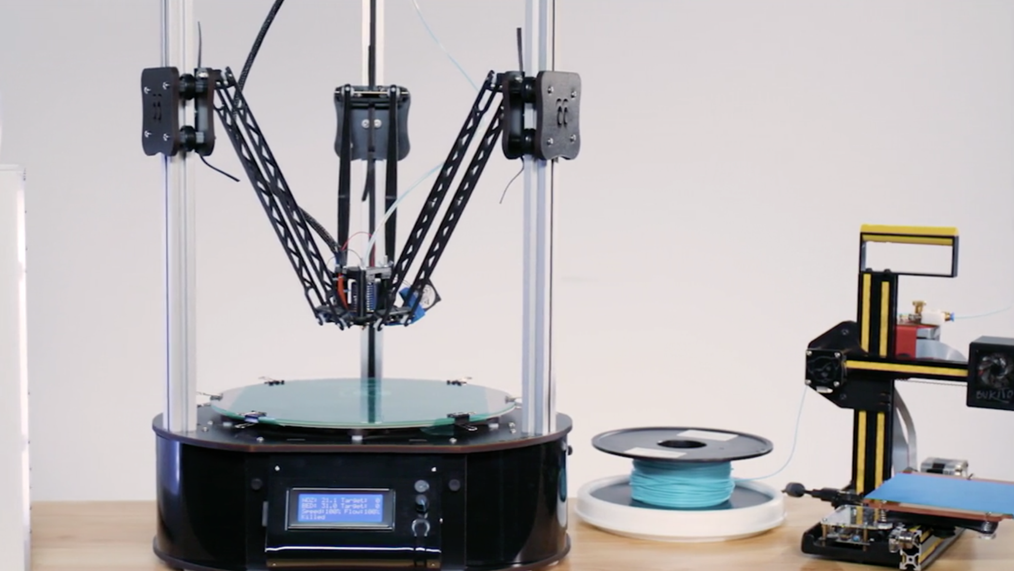
COURSE SLIDES · WSQ
Innovating Product Development with 3D Printing and Additive Manufacturing
WSQ Course Code: TGS-2022017597 · TSC: Additive Manufacturing (PRE-OPR-4012-1.1)
Conducted by Tertiary Infotech Academy Pte Ltd · UEN 201200696W
Version v8.1 · 22 August 2026
© 2026 Tertiary Infotech Academy Pte Ltd. All rights reserved. · www.tertiarycourses.com.sg

Slide 2
COURSE ADMINISTRATION
Welcome & Housekeeping
Innovating Product Development with 3D Printing and Additive · TGS-2022017597
© 2026 Tertiary Infotech Academy Pte Ltd
2

Slide 3
TRAQOM · SSG DIGITAL ATTENDANCE
Digital Attendance (Mandatory)
AM · PM · Assessment
It is mandatory to take the AM, PM and Assessment digital attendance for WSQ-funded courses.
SSG QR code
The trainer/administrator displays the digital attendance QR code generated from the SSG portal.
1
2
Scan & submit
Scan the QR code with your mobile phone camera and submit your attendance each session.
75% minimum
A minimum of 75% attendance is required to be eligible for assessment and funding.
3
4
Innovating Product Development with 3D Printing and Additive · TGS-2022017597
© 2026 Tertiary Infotech Academy Pte Ltd
3

Slide 4
YOUR TRAINER · GENERAL
About the Trainer
NAME
____________________________________________
?
TITLE / DESIGNATION
____________________________________________
QUALIFICATIONS
____________________________________________
Your Trainer
AREAS OF EXPERTISE
____________________________________________
General Trainer template —
to be completed by the trainer
TRAINING & INDUSTRY EXPERIENCE
____________________________________________
CONTACT
____________________________________________
Innovating Product Development with 3D Printing and Additive · TGS-2022017597
© 2026 Tertiary Infotech Academy Pte Ltd
4

Slide 5
YOUR TRAINER
About the Trainer
ROLE
Principal Trainer and Founder, Tertiary Infotech Academy Pte Ltd
AA
QUALIFICATIONS
PhD — data science, engineering and emerging-technology educator.
Dr Alfred Ang
DELIVERS
WSQ courses on 3D printing & additive manufacturing, CAD/product design, data science and AI.
Principal Trainer
Tertiary Infotech Academy Pte Ltd
EXPERIENCE
20+ years of industry training across engineering, manufacturing and technology domains.
Innovating Product Development with 3D Printing and Additive · TGS-2022017597
© 2026 Tertiary Infotech Academy Pte Ltd
5

Slide 6
ICE-BREAKER
Let's Know Each Other
• Your name and organisation / role.
• Your experience with CAD, 3D printing or manufacturing (if any).
• What you want to design, prototype or manufacture after this course.
Innovating Product Development with 3D Printing and Additive · TGS-2022017597
© 2026 Tertiary Infotech Academy Pte Ltd
6

Slide 7
HOUSEKEEPING
Ground Rules
Set your mobile phone to silent mode.
Participate actively — no question is too small.
1
2
Mutual respect: agree to disagree.
One conversation at a time.
3
4
Be punctual; return from breaks on time.
75% attendance is required.
5
6
Innovating Product Development with 3D Printing and Additive · TGS-2022017597
© 2026 Tertiary Infotech Academy Pte Ltd
7

Slide 8


COURSE PORTAL
Login to LMS and Download Course Material
Log in at lms-tms.tertiaryinfotech.com with your registered email and the OTP sent to your inbox, then open this course to download the slides and Learner Guide.
Innovating Product Development with 3D Printing and Additive · TGS-2022017597
© 2026 Tertiary Infotech Academy Pte Ltd
8

Slide 9
COURSE PORTAL · LMS/TMS
Download Course Material
1 · Visit the portal
Go to https://lms-tms.tertiaryinfotech.com in your browser.
2 · Login with OTP
Enter your registered email and key in the One-Time Password sent to you.
3 · Open your course
Select this course under My Courses.
4 · Download materials
Download the slides and Learner Guide for the open-book assessment.
lms-tms.tertiaryinfotech.com — your course portal login page
Innovating Product Development with 3D Printing and Additive · TGS-2022017597
© 2026 Tertiary Infotech Academy Pte Ltd
9

Slide 10
SCHEDULE
Lesson Plan — 2 Days, 8 Hours/Day
Day 1
Day 2
• Day 1 — Additive Manufacturing, 3D Scanning and Design for AM
– Digital Attendance (AM)
– Trainer and learner introductions · Learning outcomes
– Topic 1: Overview of AM and 3D Scanning (Labs 1–6)
– Lunch break · Digital Attendance (PM)
– Topic 2 begins: Process Related Issues (Lab 7)
• Day 2 — Process Issues, Process Improvement and Assessment
– Digital Attendance (AM)
– Topic 2: Process Related Issues for AM (Labs 8–10)
– Topic 3: Process Improvement for AM (Labs 11–16)
– Revision · Course feedback · TRAQOM survey
– Digital Attendance (Assessment) · Final Assessment (WA + PP)
Innovating Product Development with 3D Printing and Additive · TGS-2022017597
© 2026 Tertiary Infotech Academy Pte Ltd
10

Slide 11
SKILLS FRAMEWORK
Skills Framework — TSC
TSC Title
Additive Manufacturing
TSC Code
PRE-OPR-4012-1.1
1
2
Framework
Skills Framework for Precision Engineering — Additive Manufacturing
Proficiency
Level 4 — analyse, determine, evaluate and optimise AM processes
3
4
Innovating Product Development with 3D Printing and Additive · TGS-2022017597
© 2026 Tertiary Infotech Academy Pte Ltd
11

Slide 12
SKILLS FRAMEWORK · ABILITIES
TSC Abilities
• A1: Analyse and determine material considerations of components to be manufactured
• A2: Analyse process-related issues for using DMLS, SLS, SLM, powder bed and inkjet head, and/or 3D printing for AM
• A3: Determine processes and procedures for manufacturing metallic and non-metallic components using AM
• A4: Evaluate use of reverse engineering processes for components through 3D scanning and subsequent AM
• A5: Apply optimisation techniques to improve efficiency of AM processes and product quality
• A6: Assess the impact of manufacturing process improvements on business operations
Innovating Product Development with 3D Printing and Additive · TGS-2022017597
© 2026 Tertiary Infotech Academy Pte Ltd
12

Slide 13
SKILLS FRAMEWORK · KNOWLEDGE
TSC Knowledge
• K1: AM characteristics, techniques and systems
• K2: Requirements of different AM processes
• K3: Factors to be considered when selecting AM solutions
• K4: Impact of AM on manufacturing operations
• K5: Methods for reviewing AM performance
• K6: Benefits and trade-offs of AM
• K7: Methods of ensuring long-term sustainability of AM
Innovating Product Development with 3D Printing and Additive · TGS-2022017597
© 2026 Tertiary Infotech Academy Pte Ltd
13

Slide 14
WHAT YOU'LL ACHIEVE
Learning Outcomes
LO1 — Analyse AM & 3D scanning
Analyze the AM and evaluate the use of reverse engineering using 3D scanning.
1
LO2 — Analyse process issues
Analyze the issues and determine the requirements for AM processes.
2
LO3 — Optimise & assess
Apply AM optimization techniques and assess the impact of process improvement.
3
Innovating Product Development with 3D Printing and Additive · TGS-2022017597
© 2026 Tertiary Infotech Academy Pte Ltd
14

Slide 15
2 DAYS · 16 HOURS
Course Outline
Topic 1 · Overview
Topic 2 · Process Issues
Topic 3 · Improvement
• Overview of AM systems
• Material considerations for AM
• Benefits and trade-offs of AM
• AM with 3D scanning
• Design for AM in Fusion 360
• Labs 1–6
• Printer hardware & slicing
• Bed adhesion: skirt/brim/raft
• Extrusion & temperature issues
• Filaments and materials
• Hybrid metal + polymer parts
• Labs 7–10
• Infill and wall optimisation
• Surface quality & textures
• Support strategy
• Post-processing chains
• Business impact & sustainability
• Labs 11–16
Innovating Product Development with 3D Printing and Additive · TGS-2022017597
© 2026 Tertiary Infotech Academy Pte Ltd
15

Slide 16
ASSESSMENT RULES
Briefing for Assessment
Place phones and other materials under the table or on the floor.
No photos or recording of assessment scripts.
1
2
No discussion during the assessment.
Use a black/blue pen for hard-copy assessments.
3
4
No liquid paper / correction tape.
Scripts are collected when time is up.
5
6
Innovating Product Development with 3D Printing and Additive · TGS-2022017597
© 2026 Tertiary Infotech Academy Pte Ltd
16

Slide 17
FINAL ASSESSMENT
Assessment
Written Assessment (WA)
Short-Answer Questions (SAQ) — 1 hour, open book.
Practical Performance (PP)
Scenario-based practical tasks — 90 minutes, open book.
1
2
Open book
Slides, Learner Guide and approved materials only.
Eligibility
Minimum 75% attendance to be eligible for assessment and funding.
3
4
Appeal
An appeal process is available if required.
Outcome
Competent (C) / Not Yet Competent (NYC) recorded on the Assessment Summary Record.
5
6
Innovating Product Development with 3D Printing and Additive · TGS-2022017597
© 2026 Tertiary Infotech Academy Pte Ltd
17

Slide 18
ON ASSESSMENT DAY
Assessment Flow
1
2
3
4
5
▶
▶
▶
▶
TRAQOM survey — scan the QR code on the LMS
Assessment digital attendance — scan the SSG QR
Sit WA (SAQ) then the Practical Performance — open book
Upload your answers on the LMS
Sign the Assessment Summary Record
Innovating Product Development with 3D Printing and Additive · TGS-2022017597
© 2026 Tertiary Infotech Academy Pte Ltd
18

Slide 19
01
TOPIC 01
Overview of Additive Manufacturing and 3D Scanning
AM systems · material considerations · benefits & trade-offs · 3D scanning and reverse engineering (K1, K3, K6 · A1, A4)
Innovating Product Development with 3D Printing and Additive · TGS-2022017597
© 2026 Tertiary Infotech Academy Pte Ltd
19

Slide 20
OVERVIEW · K1
What is Additive Manufacturing?
Layer-by-layer fabrication
AM builds parts by depositing material layer upon layer, directly from a computer-aided design (CAD) file.
No part-specific tooling
No dies, molds or fixtures — the digital file is the tooling, so design changes cost nothing to retool.
1
2
Freeform geometry
Multiple layers built in the X–Y plane stack along Z, enabling shapes machining cannot reach.
Rapid & flexible
Concept-to-part in hours enables fast prototyping, iteration and mass customisation.
3
4
Innovating Product Development with 3D Printing and Additive · TGS-2022017597
© 2026 Tertiary Infotech Academy Pte Ltd
20

Slide 21
TWO PHILOSOPHIES · K1
Additive vs Subtractive Manufacturing
Add material
Remove material
• Additive (AM)
– Builds the part up layer by layer
– Material only where needed — minimal scrap
– Complexity is essentially free
– No tooling — economic at lot size one
– Slower per part at high volumes
• Subtractive (CNC/machining)
– Cuts material away from a solid block
– Significant chip/scrap waste
– Complex internal features often impossible
– Tooling & setup favour large volumes
– Excellent finish and tight tolerances
Innovating Product Development with 3D Printing and Additive · TGS-2022017597
© 2026 Tertiary Infotech Academy Pte Ltd
21

Slide 22
TERMINOLOGY
3D Printing vs Additive Manufacturing
3D printing
Strictly, the build step — the machine depositing layers. The term the consumer world uses.
Additive manufacturing
The full industrial workflow: design, simulation, build, post-processing, inspection and certification.
1
2
Same core, different scope
Every AM part is 3D printed — but AM adds the engineering discipline around the print.
In this course
We use both terms; Topic 2–3 cover the process discipline that turns printing into manufacturing.
3
4
Innovating Product Development with 3D Printing and Additive · TGS-2022017597
© 2026 Tertiary Infotech Academy Pte Ltd
22

Slide 23
MILESTONES
A Brief History of 3D Printing
1
2
3
4
5
▶
▶
▶
▶
1981 — Hideo Kodama publishes the first layer-by-layer photopolymer method
1984–87 — Chuck Hull invents SLA and ships the first commercial system
1988–92 — FDM patented by Scott Crump; SLS emerges for powders
2009 — key FDM patents expire; RepRap & desktop printing explode
Today — metal AM flies in aircraft, implants and rockets
Innovating Product Development with 3D Printing and Additive · TGS-2022017597
© 2026 Tertiary Infotech Academy Pte Ltd
23

Slide 24
CAD TO PART
The 3D Printing Workflow
1
2
3
4
5
▶
▶
▶
▶
DESIGN — model the part in CAD (Fusion 360) or capture it by 3D scanning
EXPORT — tessellate to an STL/3MF mesh file
SLICE — the slicer (Cura) converts the mesh to layer toolpaths (G-code)
PRINT — the machine builds the part layer by layer
POST-PROCESS — remove supports, cure, finish, inspect
Innovating Product Development with 3D Printing and Additive · TGS-2022017597
© 2026 Tertiary Infotech Academy Pte Ltd
24

Slide 25
TECHNOLOGY MAP · K1
The 7 AM Process Families (ISO/ASTM 52900)
1
Material Extrusion
FDM/FFF — molten filament laid down in beads. Desktop standard.
2
Vat Photopolymerisation
SLA, DLP, LCD/MSLA — light cures liquid resin, layer by layer.
3
Powder Bed Fusion
SLS, DMLS, SLM, EBM — laser/e-beam fuses powder layers.
4
Material Jetting
PolyJet/NanoParticle jetting — droplets of material UV-cured in place.
5
Binder Jetting
Liquid binder glues powder — metals, sand moulds, full-colour parts.
6
Directed Energy Deposition
Blown powder or wire melted by laser/arc — repair & large metal parts.
7
Sheet Lamination
LOM, ultrasonic consolidation — sheets bonded and cut.
8
Hybrid systems
AM + CNC finishing in one machine — additive build, subtractive precision.
Innovating Product Development with 3D Printing and Additive · TGS-2022017597
© 2026 Tertiary Infotech Academy Pte Ltd
25

Slide 26
PROCESS FAMILIES 2–3 · K1
Vat Photopolymerisation & Powder Bed Fusion
SLA
A UV laser cures resin one small spot at a time — fine detail, smooth finish.
DLP / LCD (MSLA)
A projector or LCD mask cures a whole layer at once — speed at pixel resolution.
1
2
SLS
A laser sinters polymer powder — tough nylon parts, no supports needed.
LPBF / DMLS / SLM
Laser powder bed fusion of metals — sintered (DMLS) or fully melted (SLM).
3
4
EBM
An electron beam melts metal powder in vacuum — aerospace titanium.
MJF
HP Multi Jet Fusion — agent + IR lamps fuse nylon powder fast.
5
6
Innovating Product Development with 3D Printing and Additive · TGS-2022017597
© 2026 Tertiary Infotech Academy Pte Ltd
26

Slide 27
TOPIC 01 · FDM
Printing with Filament (FDM)
Layer on layer
Each layer prints on top of the previous one, up from the build platform — like building a wall.
Needs a base
The first layer must stick to the platform; poor bases need adhesion aids or redesign.
Overhangs need support
Sudden overhangs print into mid-air — the slicer generates removable support structures.
Design to avoid supports
Orient and design parts to minimise supports: faster prints, better surfaces.
Desktop FDM printers — cartesian and delta architectures
Innovating Product Development with 3D Printing and Additive · TGS-2022017597
© 2026 Tertiary Infotech Academy Pte Ltd
27

Slide 28
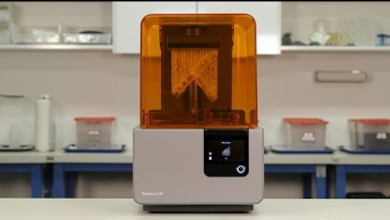
TOPIC 01 · RESIN
Printing with Resin (SLA / DLP / LCD)
UV-curable resin
A tray of liquid photopolymer is selectively hardened by a light source.
Laser vs projector
SLA cures spot by spot; DLP/LCD cure an entire layer at once — features as fine as a pixel.
Printed solid
Resin parts usually print solid or drained — trapped liquid resin cannot stay inside.
Post-cure required
Wash in IPA, then UV post-cure to reach full strength — always with gloves.
A desktop SLA resin printer with its UV-blocking cover
Innovating Product Development with 3D Printing and Additive · TGS-2022017597
© 2026 Tertiary Infotech Academy Pte Ltd
28

Slide 29
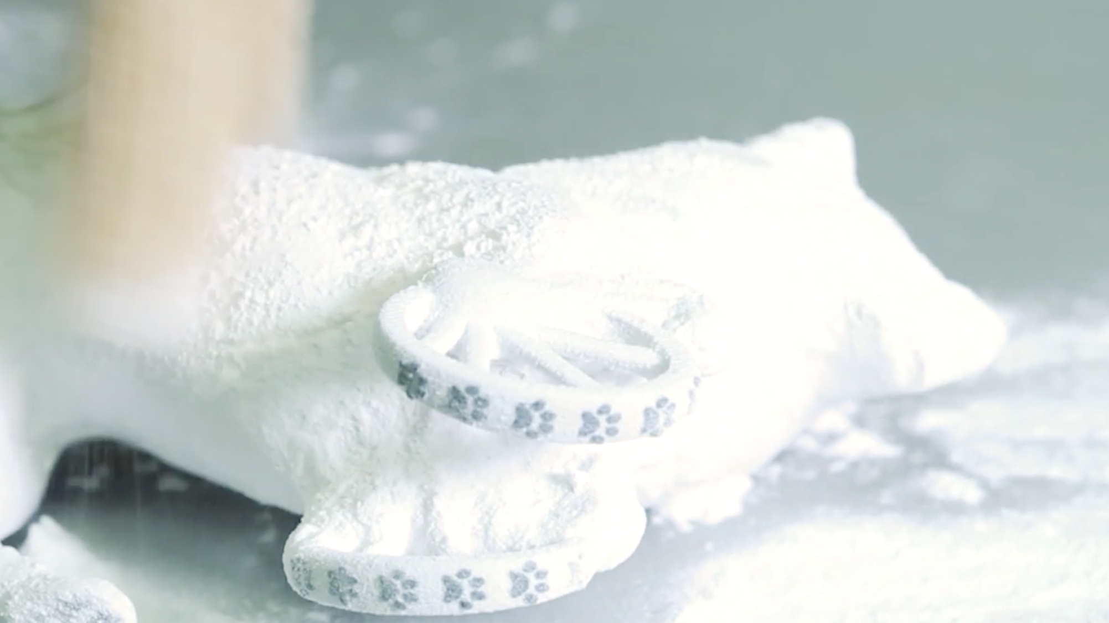
TOPIC 01 · POWDER
Printing with Powder (SLS / Metal PBF)
Most aggressive complexity
Unfused powder supports the part, freeing the most complex geometries in AM.
Industrial territory
Powder is messy and metal powders are an explosion hazard — not a casual in-house setup.
Post-processing heavy
Depowdering, heat treatment and finishing depend on technology and material.
Nylon to titanium
From SLS nylon ducting to DMLS titanium implants and rocket injectors.
An SLS part emerging from its unsintered powder cake
Innovating Product Development with 3D Printing and Additive · TGS-2022017597
© 2026 Tertiary Infotech Academy Pte Ltd
29

Slide 30
DMLS · SLS · SLM · K1/K2
Metal Powder Bed Fusion — Three Siblings
DMLS — sinter
SLS — polymers
SLM — full melt
• Laser fuses metal powder by sintering — heat without full melting
• Stainless, cobalt-chrome, aluminium, Inconel
• Dental implants, aerospace brackets
• Same principle applied to thermoplastic powders
• Tough nylon (PA12) parts
• No support structures — powder is the support
• Laser fully melts the metal to a liquid state
• Denser parts, higher residual stress
• Demands tight process control
Innovating Product Development with 3D Printing and Additive · TGS-2022017597
© 2026 Tertiary Infotech Academy Pte Ltd
30

Slide 31
MATERIALS · K2/K3
AM Materials Palette
Polymers
PLA, ABS, PETG, Nylon, TPU filaments; photopolymer resins; PA12 powders.
Metals
Stainless & tool steels, titanium, aluminium, cobalt-chrome, Inconel, copper.
1
2
Ceramics & composites
Technical ceramics, carbon/glass-fibre filled polymers, metal-matrix blends.
Specialty
Wood/metal/stone-filled, conductive, magnetic, glow, flexible TPE, bio-inks.
3
4
Innovating Product Development with 3D Printing and Additive · TGS-2022017597
© 2026 Tertiary Infotech Academy Pte Ltd
31

Slide 32
K3 · CHOOSING WISELY
Selecting an AM Solution — Decision Factors
Material properties
Mechanical strength, temperature, chemical resistance and biocompatibility the part must deliver.
Design complexity
Feature detail, internal channels, overhangs — some processes resolve far finer detail than others.
1
2
Volume & speed
Prototyping favours AM at lot size one; beyond ~100s of units, moulding usually wins.
Post-processing
Supports, curing, machining, finishing — each process carries its own downstream cost.
3
4
Cost structure
Machine, material, labour and energy per part — plus capital outlay and maintenance.
Learning curve
Operator skill, software toolchain and process maturity in your team.
5
6
Innovating Product Development with 3D Printing and Additive · TGS-2022017597
© 2026 Tertiary Infotech Academy Pte Ltd
32

Slide 33
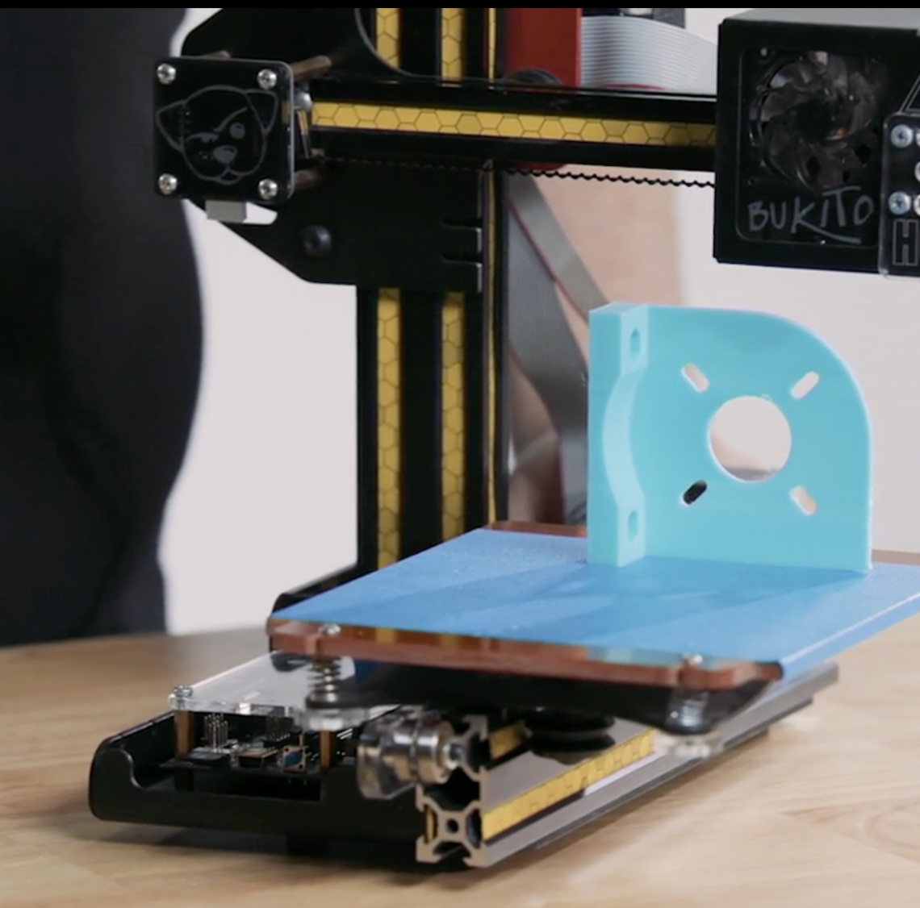
K3 · PROCUREMENT
Considerations When Buying a 3D Printer
Cost
Machine price, materials, spares and running cost per printed hour.
Learning curve
From plug-and-print desktop FDM to industrial PBF needing trained operators.
Build volume
Big printers cost and occupy exponentially more — match to your part sizes.
Capital & maintenance
Ventilation, power, calibration schedules and service contracts.
A desktop FDM printer mid-print
Innovating Product Development with 3D Printing and Additive · TGS-2022017597
© 2026 Tertiary Infotech Academy Pte Ltd
33

Slide 34
K6 · WHY AM WINS
Benefits of Additive Manufacturing
Design freedom
Complex geometry is free — internal lattices, conformal channels, organic forms.
Rapid prototyping
Idea to physical part in hours; iterate daily instead of quarterly.
1
2
Mass customisation
Every part can differ at no extra cost — dental, hearing aids, prosthetics.
Less waste
Material is placed only where needed — high buy-to-fly ratios beaten dramatically.
3
4
No tooling
Skip molds and dies entirely — economic at lot size one, instant design changes.
Distributed production
Ship files, not parts — print at the point of need.
5
6
Innovating Product Development with 3D Printing and Additive · TGS-2022017597
© 2026 Tertiary Infotech Academy Pte Ltd
34

Slide 35
K6 · EYES OPEN
Trade-offs of Additive Manufacturing
Throughput
Layer-by-layer is slow — injection moulding beats AM beyond hundreds of units.
Mechanical anisotropy
Parts are typically 10–50% weaker across layer boundaries than moulded equivalents.
1
2
Material range
Far fewer qualified materials than conventional manufacturing, and often costlier.
Surface & accuracy
Layer lines and dimensional tolerance often demand post-processing.
3
4
Post-processing load
Support removal, curing, heat treatment — hidden time and labour.
Repeatability & QA
Process variation makes certification harder — a live research frontier (NIST).
5
6
Innovating Product Development with 3D Printing and Additive · TGS-2022017597
© 2026 Tertiary Infotech Academy Pte Ltd
35

Slide 36
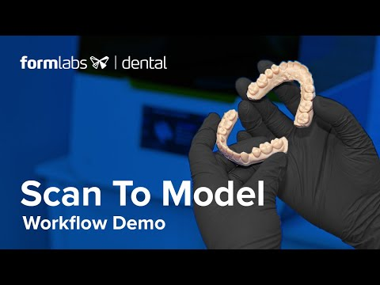
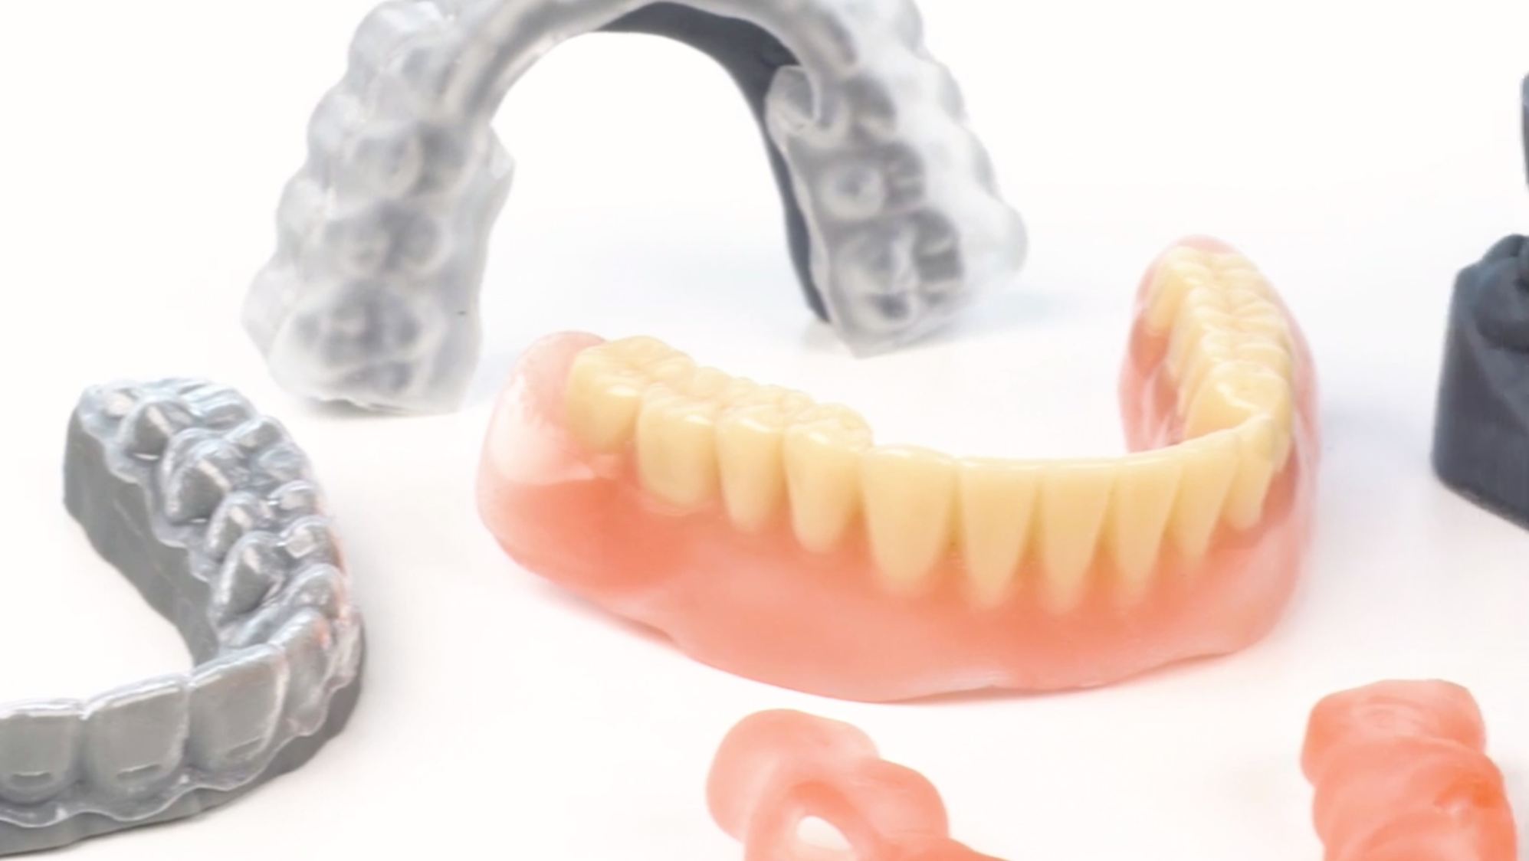
CASE STUDY · K4/K6
Case Study — Digital Dentistry
3D-printed dental models and appliances
Scan-to-model workflow: intraoral scan → print
Innovating Product Development with 3D Printing and Additive · TGS-2022017597
© 2026 Tertiary Infotech Academy Pte Ltd
36

Slide 37
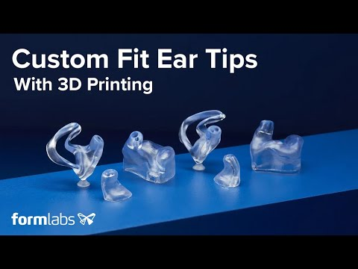
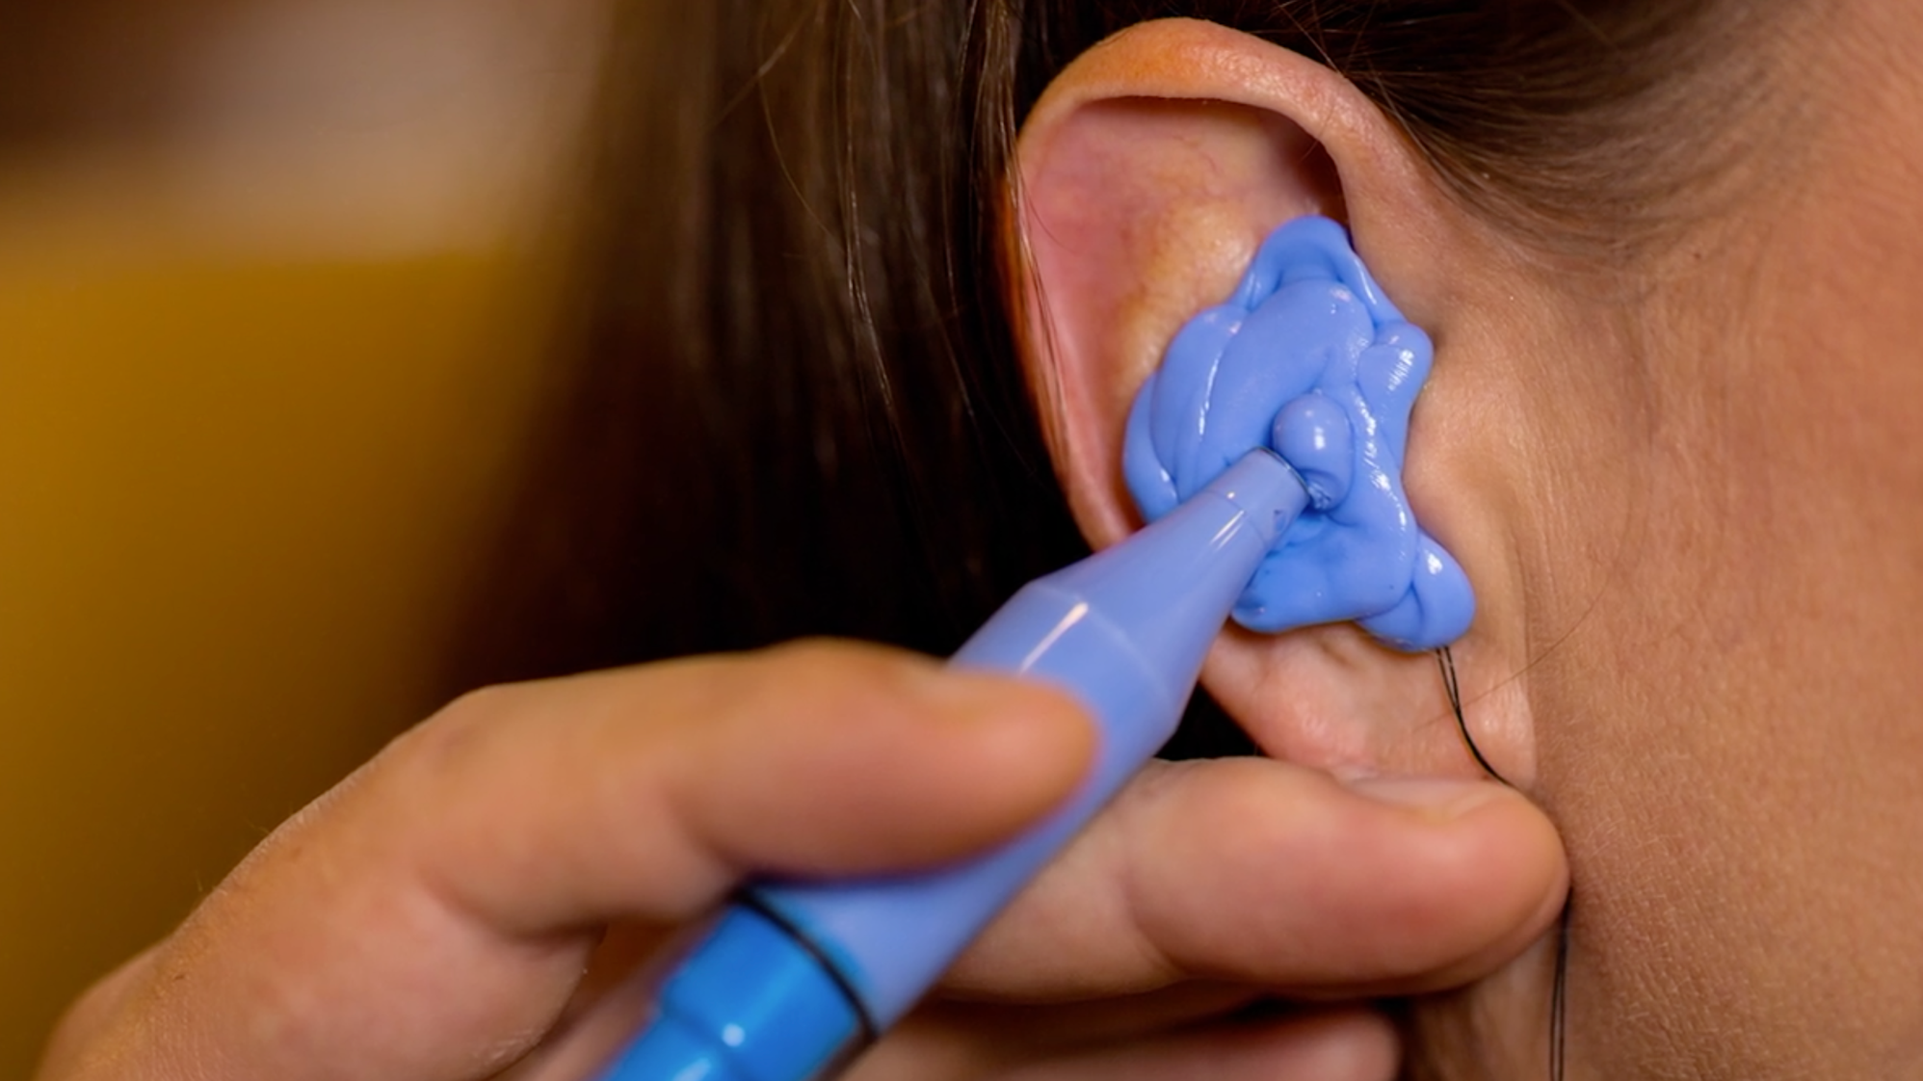
CASE STUDY · MASS CUSTOMISATION · 99% OF SHELLS ARE 3D-PRINTED
Case Study — Hearing Aids
Ear impression captured for a custom fit
Custom-fit 3D-printed ear tips
Innovating Product Development with 3D Printing and Additive · TGS-2022017597
© 2026 Tertiary Infotech Academy Pte Ltd
37

Slide 38
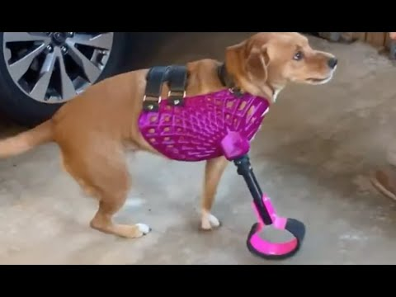
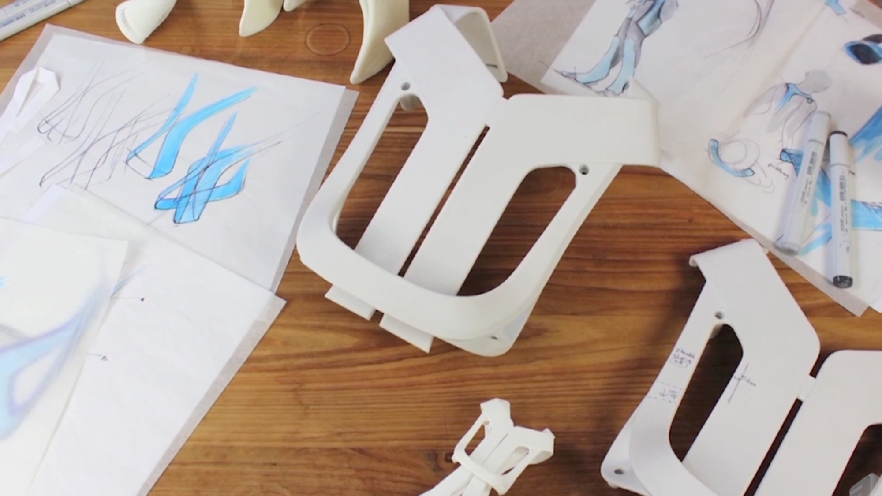
CASE STUDY · ACCESSIBLE ENGINEERING
Case Study — Prosthetics for Humans and Animals
Printed prosthetic hand components
A dog fitted with 3D-printed prosthetic legs
Innovating Product Development with 3D Printing and Additive · TGS-2022017597
© 2026 Tertiary Infotech Academy Pte Ltd
38

Slide 39
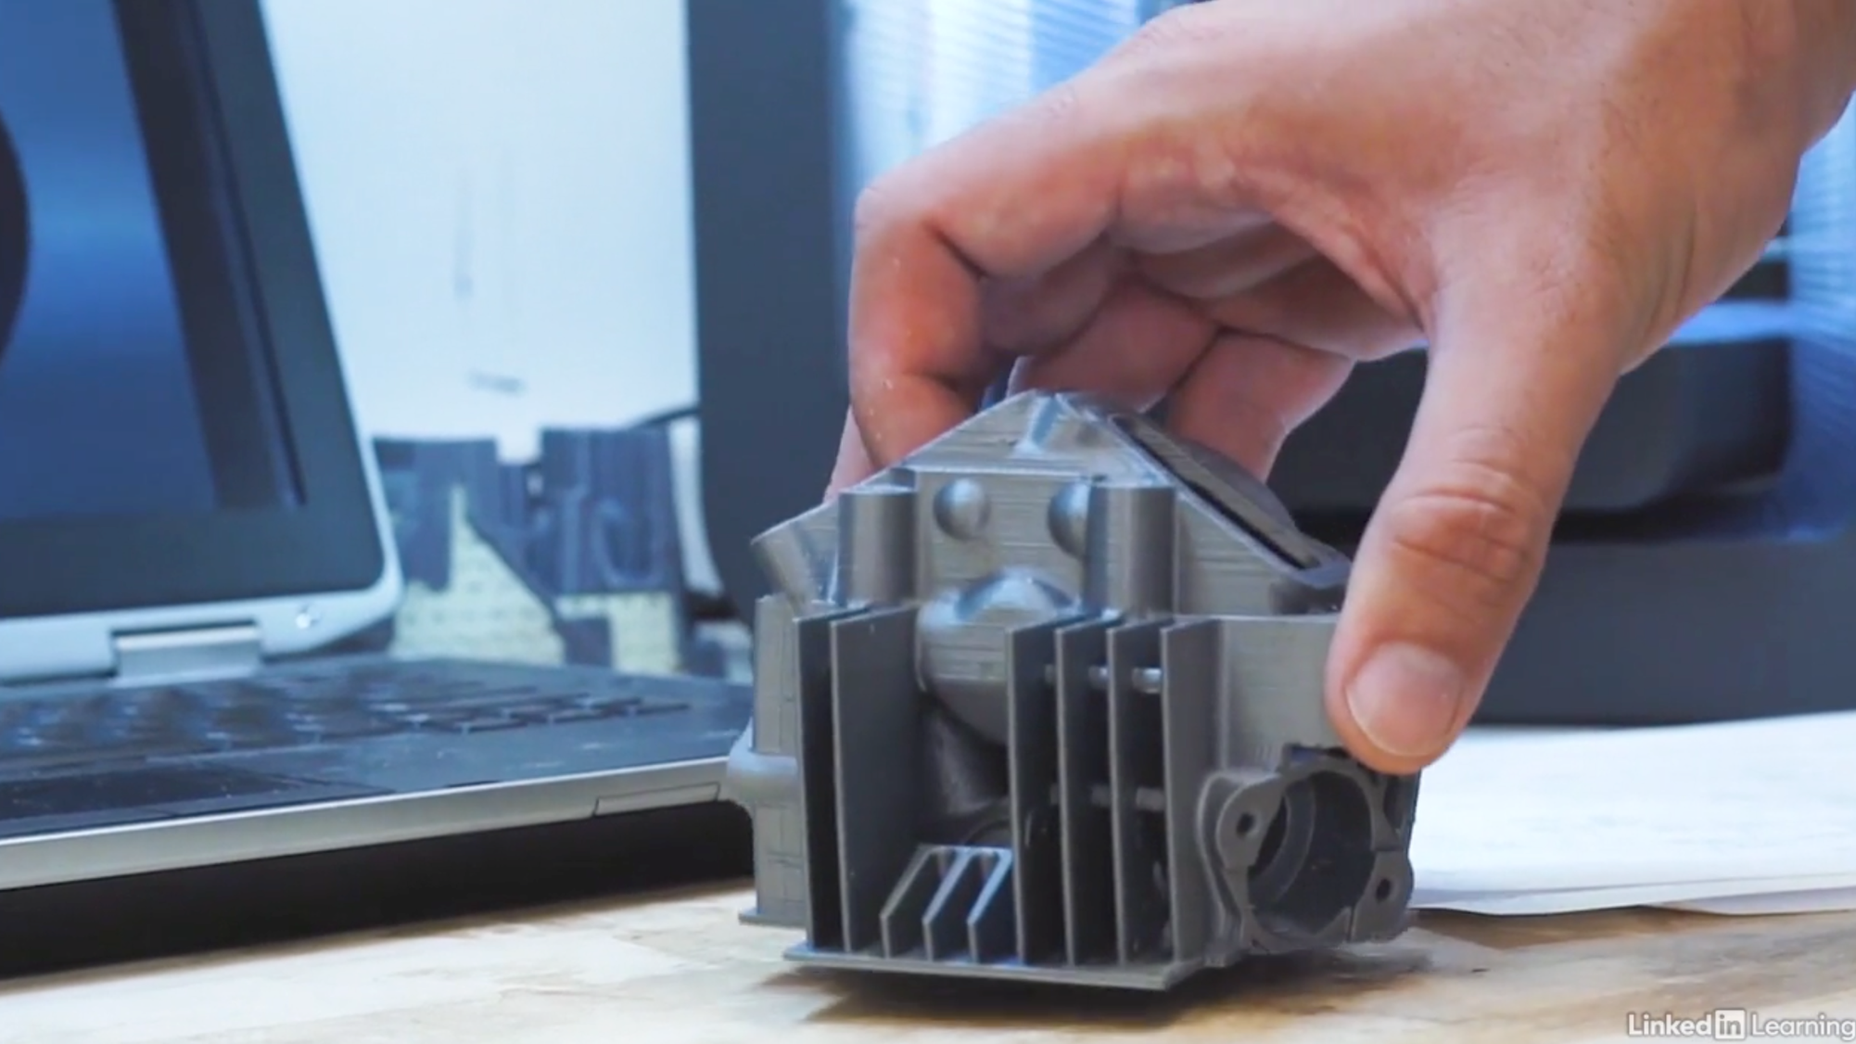
CASE STUDY · K4
Case Study — Distributed Manufacturing
Ship files, not parts
Physical goods distributed as downloadable files — like music and movies.
Print at point of need
Spare parts printed on-site cut inventory, logistics and lead time.
Real constraints
Quality and materials remain limited; printers need calibration and maintenance.
People still matter
Staff must be trained, filament supplied, tech support provided.
A replacement part printed where it is needed
Innovating Product Development with 3D Printing and Additive · TGS-2022017597
© 2026 Tertiary Infotech Academy Pte Ltd
39

Slide 40
K4 · WHO USES IT
AM Across Industries
Aerospace
Lightweight blisks, brackets and fuel nozzles — mass down, lead time down.
Automotive
Rapid prototypes, custom jigs & fixtures, low-volume spares.
1
2
Medical & dental
Patient-specific implants, surgical guides, aligners, hearing aids.
Rail & heavy industry
Bespoke obsolete spares and worn-part repair by DED.
3
4
Construction
Extruded-concrete walls and printed architectural elements.
Consumer & education
Desktop prototyping, maker culture, STEM classrooms.
5
6
Innovating Product Development with 3D Printing and Additive · TGS-2022017597
© 2026 Tertiary Infotech Academy Pte Ltd
40

Slide 41
THE DELOITTE LENS · K4/K6
Complexity is free. Customisation is free. Volume is not.
AM rewrites the economics of scope and scale — prototype and personalise with AM; mass-produce with molds.
Innovating Product Development with 3D Printing and Additive · TGS-2022017597
© 2026 Tertiary Infotech Academy Pte Ltd
41

Slide 42
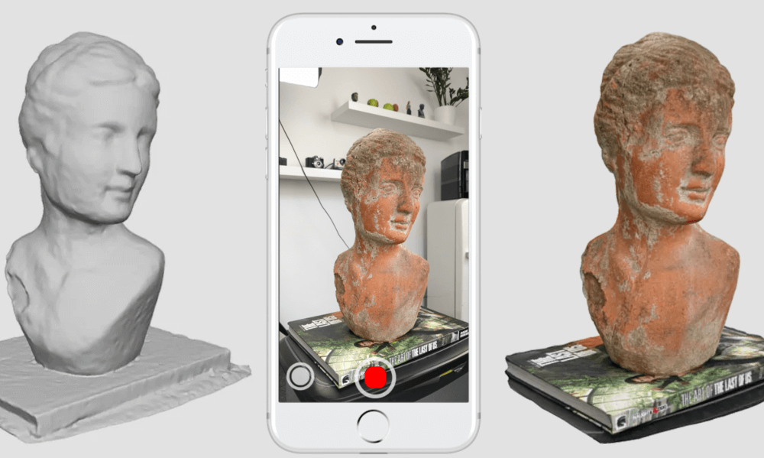
3D SCANNING · A4
3D Scanning — Capture Reality
Photogrammetry
Dozens of photos from all angles reconstructed into a textured 3D mesh.
LiDAR / structured light
Depth sensors on phones and dedicated scanners capture geometry directly.
Mobile apps
Polycam, Kiri Engine, Scandy Pro, Heges, ItSeez3D, EM3D, Trnio, Capture 3D.
Output
A mesh (STL/OBJ) ready for repair, remodelling and re-printing.
Photogrammetry: phone capture → reconstructed bust
Innovating Product Development with 3D Printing and Additive · TGS-2022017597
© 2026 Tertiary Infotech Academy Pte Ltd
42

Slide 43
TOOLBOX
3D Model Software Landscape
TinkerCAD
Free browser CAD — drag-and-drop solids, perfect first step.
Fusion 360
This course's tool — parametric sketch-driven CAD/CAM with free personal licence.
1
2
Inventor / SolidWorks
Professional parametric MCAD for production engineering.
Onshape
Full cloud CAD — CAD in a browser tab, built-in PDM.
3
4
SketchUp
Fast push-pull architectural modelling.
GrabCAD / Thingiverse / YouMagine
Model repositories — millions of ready-to-print designs.
5
6
Innovating Product Development with 3D Printing and Additive · TGS-2022017597
© 2026 Tertiary Infotech Academy Pte Ltd
43

Slide 44
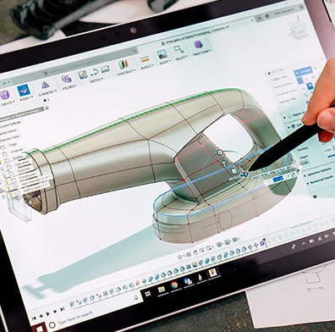
DESIGN FOR AM · A1
Fusion 360 — Sketch-Driven CAD
Sketch first
2D shapes drawn on sketch planes become 3D parts through modelling operations.
Dimension-accurate
Parametric dimensions drive printable, engineering-accurate geometry.
Four core techniques
Extrude, Revolve, Sweep and Loft cover most printable parts — Labs 1–4.
Beyond solids
Freeform (T-spline) and surface modelling handle organic, complex curvature.
Fusion 360 modelling a consumer product enclosure
Innovating Product Development with 3D Printing and Additive · TGS-2022017597
© 2026 Tertiary Infotech Academy Pte Ltd
44

Slide 45
A1 · TECHNIQUES → LABS
Fusion 360 — The Four Core Techniques
Extrude — Lab 1
Draw a 2D profile, push it along the third axis into a solid — the bread-and-butter operation.
Sweep — Lab 2
Move a profile along a 2D path on a perpendicular plane — tubes, clips, wires.
1
2
Revolve — Lab 4
Spin a half cross-section around an axis — funnels, vases, pulleys, bottles.
Loft — Lab 3
Blend between profiles on different planes, guided by rails — freeform vessels and transitions.
3
4
Innovating Product Development with 3D Printing and Additive · TGS-2022017597
© 2026 Tertiary Infotech Academy Pte Ltd
45

Slide 46
BEYOND SKETCHES · A1
Freeform and Surface Modelling
• Freeform (T-spline) modelling shapes organic forms by moving, rotating and scaling the points, edges and faces of primitive bodies.
• Surface modelling constructs complex curvature patch by patch, then thickens or stitches into printable solids.
• Use them when sketch-based solids cannot reach the shape — ergonomic grips, sculpted housings, scanned-form matching.
• Lab 6's scanned meshes and the torso case study are edited with exactly these tools.
Innovating Product Development with 3D Printing and Additive · TGS-2022017597
© 2026 Tertiary Infotech Academy Pte Ltd
46

Slide 47
DESIGN QUALITY · A1
Designs with Stress Concentration
What it is
A point where local stress runs far higher than the surrounding material.
Where it hides
Sharp corners, holes, notches and grooves — any sudden change in geometry.
1
2
Why AM cares
Layer boundaries + stress risers = the crack starts exactly there.
The fix
Fillet radii, tapers and relief notches ease the transition and spread the load.
3
4
Innovating Product Development with 3D Printing and Additive · TGS-2022017597
© 2026 Tertiary Infotech Academy Pte Ltd
47

Slide 48
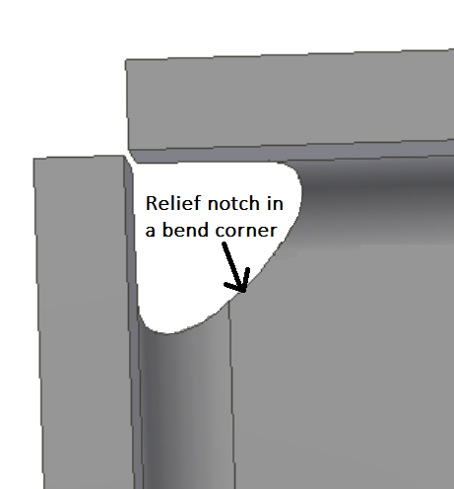
DESIGN QUALITY · A1
Design Tips to Minimise Stress Concentration
Fillet every corner
Use fillet radii or tapers to ease transitions between shapes.
Relief notches
A round relief notch stops a crack from starting in a sharp bend.
Avoid sharp corners
Especially at load-bearing intersections and layer boundaries.
Orient for strength
Put tensile loads along the layers, not across them.
A relief notch in a bend corner de-concentrates stress
Innovating Product Development with 3D Printing and Additive · TGS-2022017597
© 2026 Tertiary Infotech Academy Pte Ltd
48

Slide 49
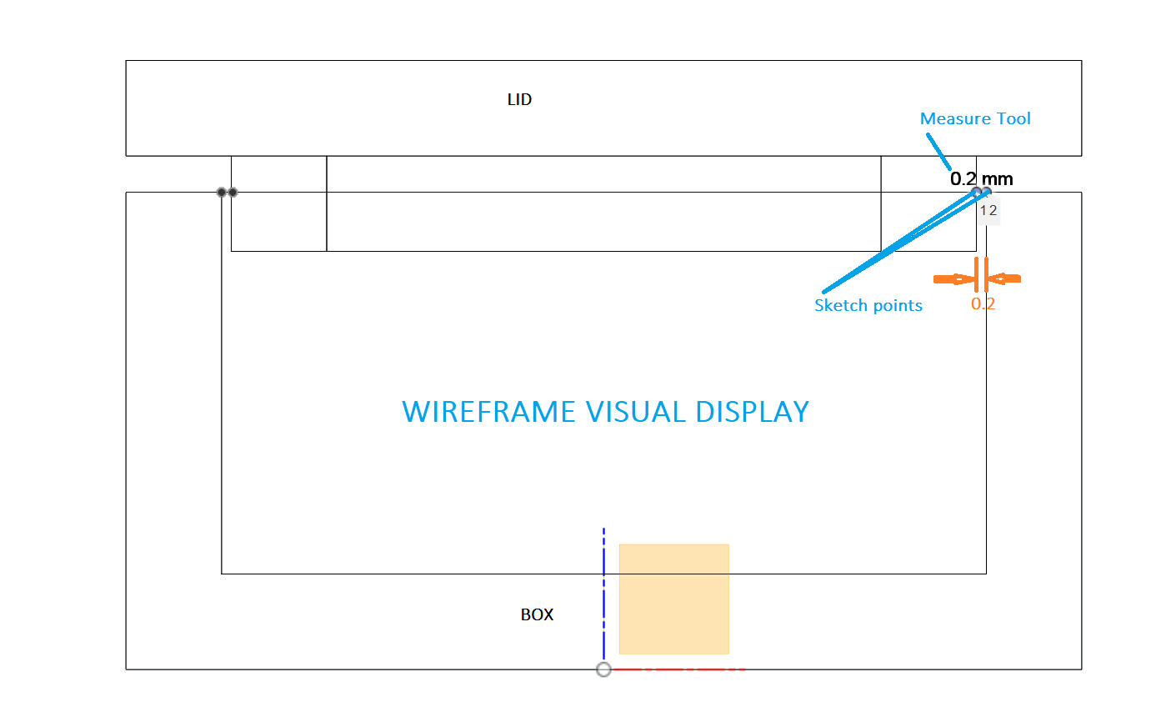
FIT & ASSEMBLY · A1
Digital and Physical Tolerance
Design the gap
Assembling parts need designed clearance — 0.2 mm is the FDM starting point.
Measure digitally
Fusion 360's Measure, Section Analysis and sketch tools verify the designed gap.
Verify physically
Digital calipers confirm the printed part reproduced the digital tolerance.
Lab 5
You'll design, print and measure a 0.2 mm container-and-lid fit.
Wireframe visual display of a lid-to-box clearance measurement
Innovating Product Development with 3D Printing and Additive · TGS-2022017597
© 2026 Tertiary Infotech Academy Pte Ltd
49

Slide 50
A4 · THE WORKFLOW
Reverse Engineering with 3D Scanning
1
2
3
4
5
▶
▶
▶
▶
IDENTIFY — inspect and repair damage on the original part
SCAN — capture it with a high-resolution 3D scanner
REFINE — clean the mesh into an accurate CAD model
SELECT — pick the AM process for the material & design
MANUFACTURE — print and post-process the component
Innovating Product Development with 3D Printing and Additive · TGS-2022017597
© 2026 Tertiary Infotech Academy Pte Ltd
50

Slide 51
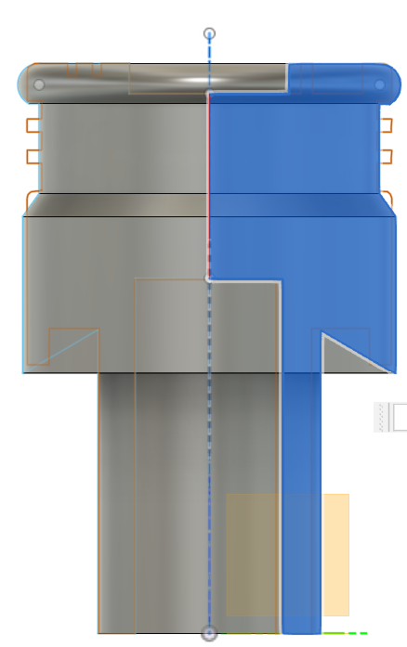
A4 · MESH → CAD
Case Study — Reverse Engineering a Mesh
Import the scan
A ready-made mesh/scan imports straight into Fusion 360.
Section the mesh
The mesh section tool produces a clean cross-section curve.
Trace & rebuild
Trace the section with a corrected sketch — fix wear and damage digitally.
Mirror & revolve
Rebuild the part as clean parametric CAD derived from the scan.
Sectioning a scanned piston mesh to recover its true profile
Innovating Product Development with 3D Printing and Additive · TGS-2022017597
© 2026 Tertiary Infotech Academy Pte Ltd
51

Slide 52
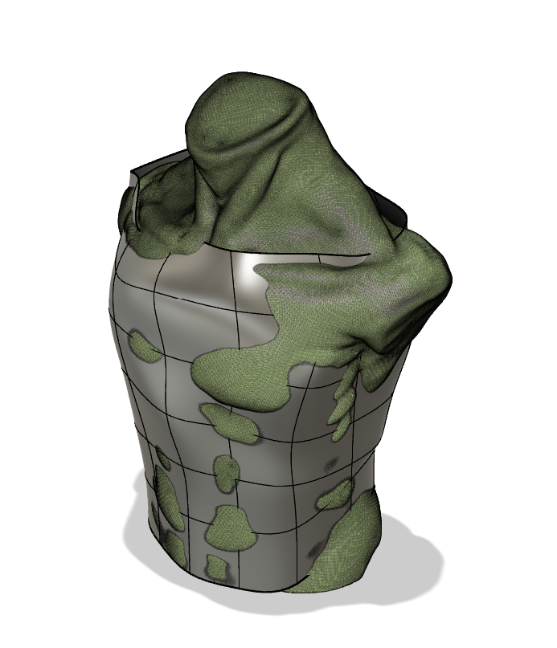
A4 · ORGANIC FORMS
Case Study — Reverse Engineering an Organic Form
Freeform cylinder
Start a freeform cylinder over the torso scan and match its contours.
Pull to the scan
The Pull tool snaps the cylinder's vertices onto the scanned surface.
Thicken
Thicken the matched surface into a printable, wearable shell.
Result
Custom-fit body armour conformal to the scanned torso.
T-spline body matched to a torso scan, ready to thicken
Innovating Product Development with 3D Printing and Additive · TGS-2022017597
© 2026 Tertiary Infotech Academy Pte Ltd
52

Slide 53
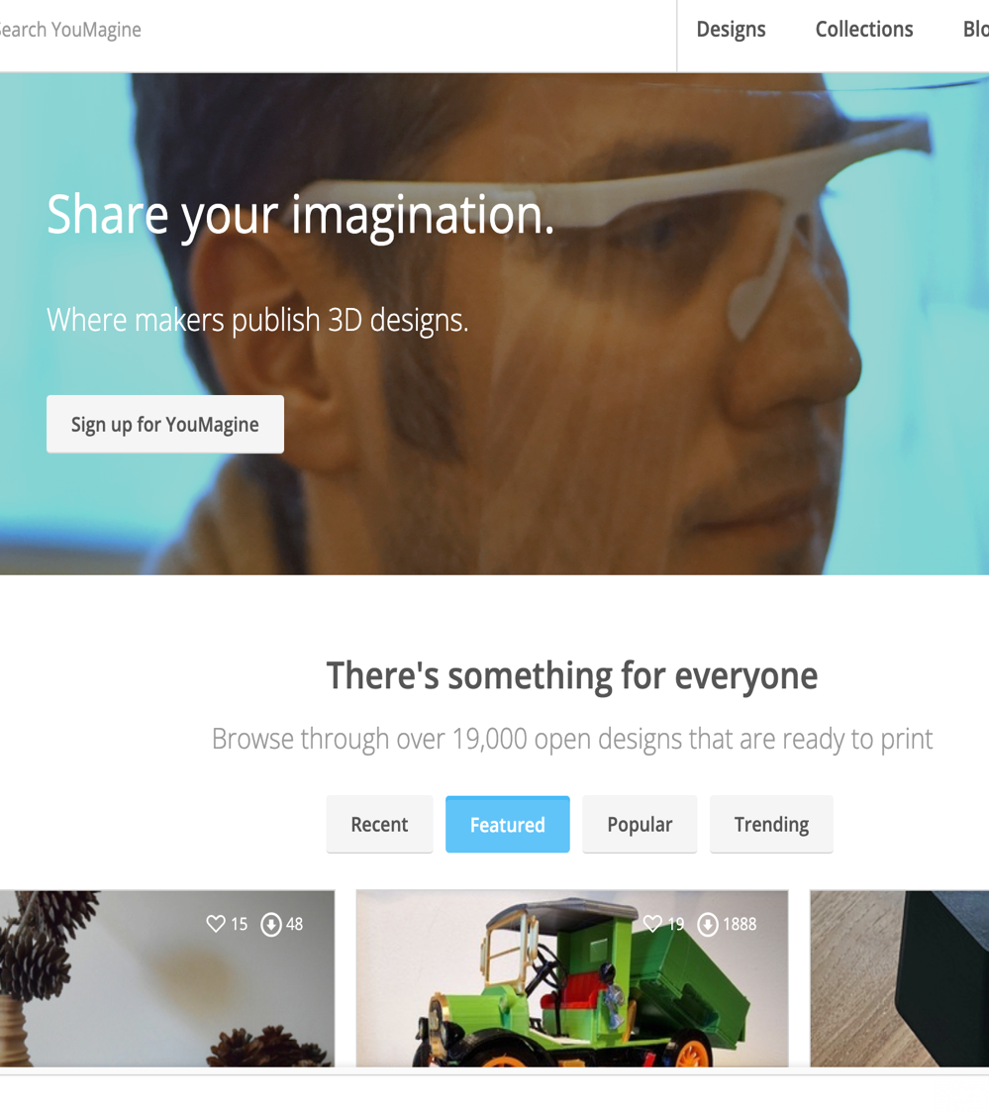
READY-MADE MODELS
3D Printing Repositories
Thingiverse
thingiverse.com — the largest free STL library.
YouMagine
youmagine.com — Ultimaker's open design community.
Printables / GrabCAD
Curated models and engineering-grade CAD downloads.
Check the licence
Respect Creative Commons terms before commercial use.
Browse, download, slice — millions of proven printable designs
Innovating Product Development with 3D Printing and Additive · TGS-2022017597
© 2026 Tertiary Infotech Academy Pte Ltd
53

Slide 54
WHAT YOU'LL DO · LABS 1–6
Hands-On Labs — Topic 1
Design for AM
Design precision
Capture reality
• Lab 1: Extrude — keychain token
• Lab 2: Sweep — paper clip
• Lab 3: Loft — plant pot
• Lab 4: Revolve — funnel
• Lab 5: Tolerance — container & lid
• Lab 6: 3D scan a real object
• Export, repair and print the scan
Innovating Product Development with 3D Printing and Additive · TGS-2022017597
© 2026 Tertiary Infotech Academy Pte Ltd
54

Slide 55
TOPIC 01 · HANDS-ON
Lab 1 — Extrude — Personalised Keychain Token
LAB 1
A1 — determine material and design considerations while modelling a printable part with the extrude technique
Model an elliptical keychain token in Fusion 360, personalise it with the first letter of your name, then slice it in Cura and 3D print it.
You'll build
A personalised elliptical keychain token, sliced and 3D printed in PLA.
Tools: Fusion 360, Ultimaker Cura, FDM printer (PLA)
Step-by-step guide: Learner Guide, Lab 1 · labs/lab-01 folder
Innovating Product Development with 3D Printing and Additive · TGS-2022017597
© 2026 Tertiary Infotech Academy Pte Ltd
55

Slide 56
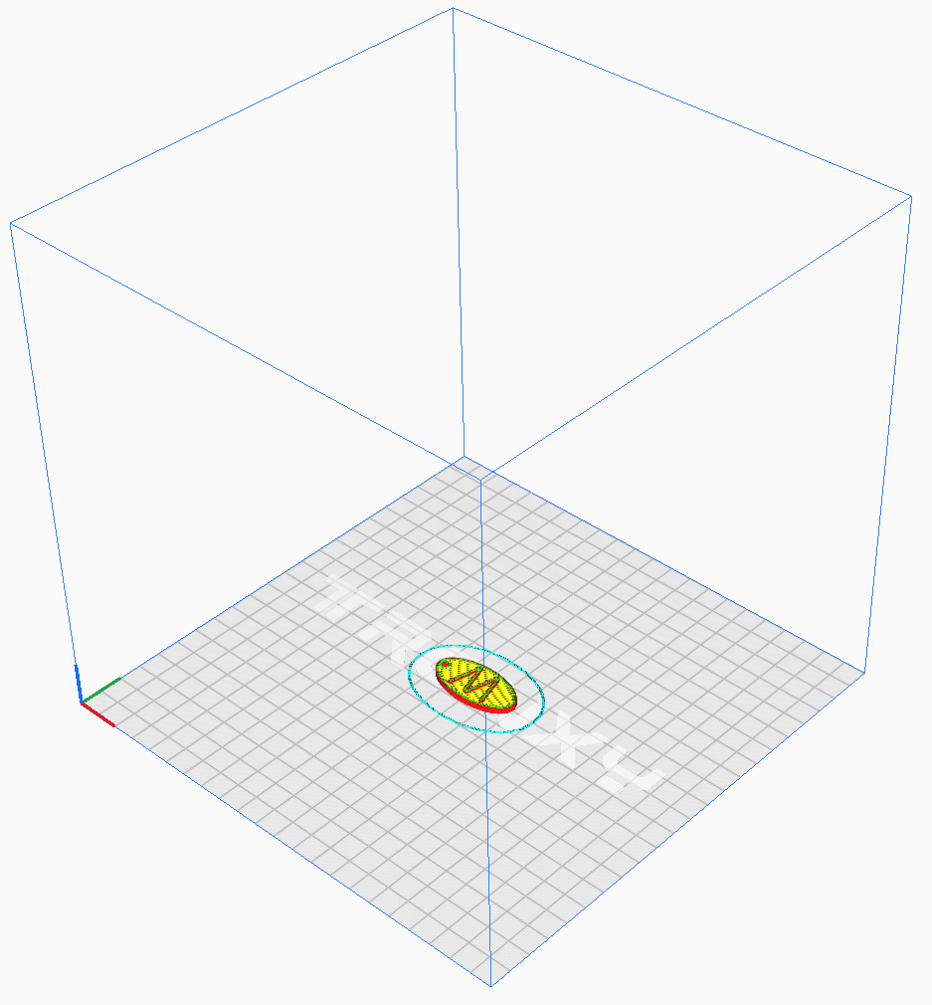
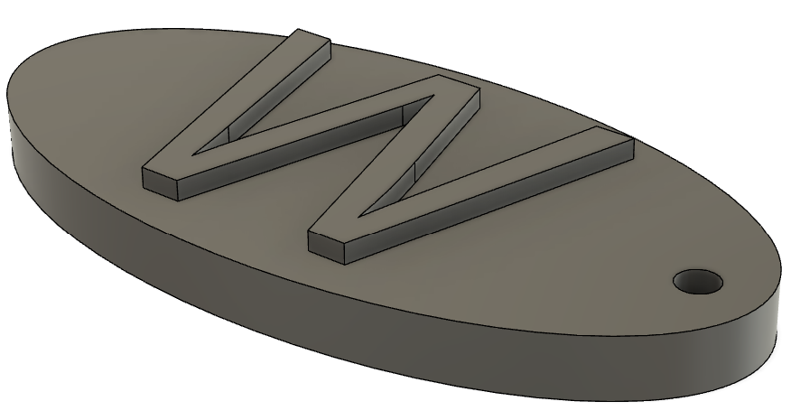
TOPIC 01 · HANDS-ON
Lab 1 — What You'll Work With
Reference — the model / setting you'll produce
Reference — as prepared in the slicer / tool
Innovating Product Development with 3D Printing and Additive · TGS-2022017597
© 2026 Tertiary Infotech Academy Pte Ltd
56

Slide 57
LAB 1 · VERIFY
Lab 1 — Extrude — Personalised Keychain Token
✅ Test it
The sliced preview shows the token printing flat with no supports; the printed token carries your raised letter and the keyring hole is clear.
Full steps and troubleshooting: Learner Guide · Lab 1
Innovating Product Development with 3D Printing and Additive · TGS-2022017597
© 2026 Tertiary Infotech Academy Pte Ltd
57

Slide 58
TOPIC 01 · HANDS-ON
Lab 2 — Sweep — Giant Paper Clip Bookmark
LAB 2
A1 — apply the sweep technique to produce a printable path-driven part
Model a giant paper clip bookmark in Fusion 360 by sweeping a circular profile along a paper-clip path, then slice and 3D print it.
You'll build
A giant paper clip bookmark modelled with the sweep technique and 3D printed flat.
Tools: Fusion 360, Ultimaker Cura, FDM printer (PLA)
Step-by-step guide: Learner Guide, Lab 2 · labs/lab-02 folder
Innovating Product Development with 3D Printing and Additive · TGS-2022017597
© 2026 Tertiary Infotech Academy Pte Ltd
58

Slide 59
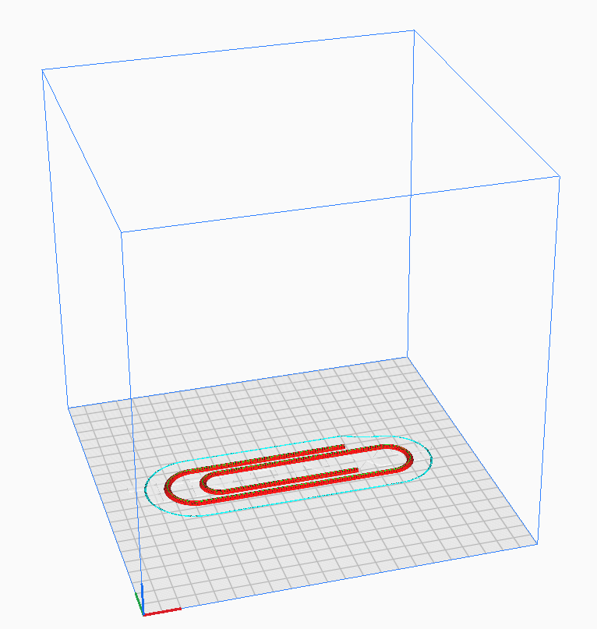
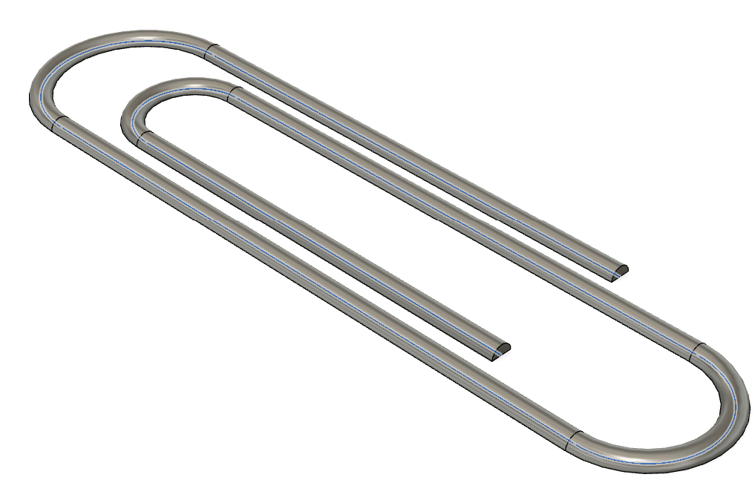
TOPIC 01 · HANDS-ON
Lab 2 — What You'll Work With
Reference — the model / setting you'll produce
Reference — as prepared in the slicer / tool
Innovating Product Development with 3D Printing and Additive · TGS-2022017597
© 2026 Tertiary Infotech Academy Pte Ltd
59

Slide 60
LAB 2 · VERIFY
Lab 2 — Sweep — Giant Paper Clip Bookmark
✅ Test it
The preview shows the whole clip printing in contact with the bed; the printed clip flexes slightly and grips a few pages like a real paper clip.
Full steps and troubleshooting: Learner Guide · Lab 2
Innovating Product Development with 3D Printing and Additive · TGS-2022017597
© 2026 Tertiary Infotech Academy Pte Ltd
60

Slide 61
TOPIC 01 · HANDS-ON
Lab 3 — Loft — Mini Plant Pot with Custom Rails
LAB 3
A1 — apply the loft technique with guide rails to create a freeform printable vessel
Model a mini plant pot in Fusion 360 by lofting between a square top and a circular base with custom guide rails, then slice and 3D print it.
You'll build
A mini plant pot lofted from circle to square, 3D printed without supports.
Tools: Fusion 360, Ultimaker Cura, FDM printer (PLA)
Step-by-step guide: Learner Guide, Lab 3 · labs/lab-03 folder
Innovating Product Development with 3D Printing and Additive · TGS-2022017597
© 2026 Tertiary Infotech Academy Pte Ltd
61

Slide 62
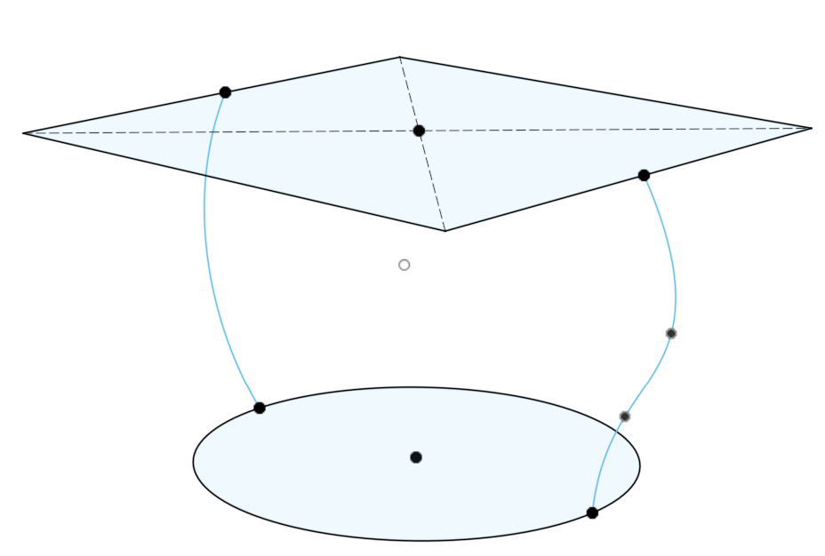
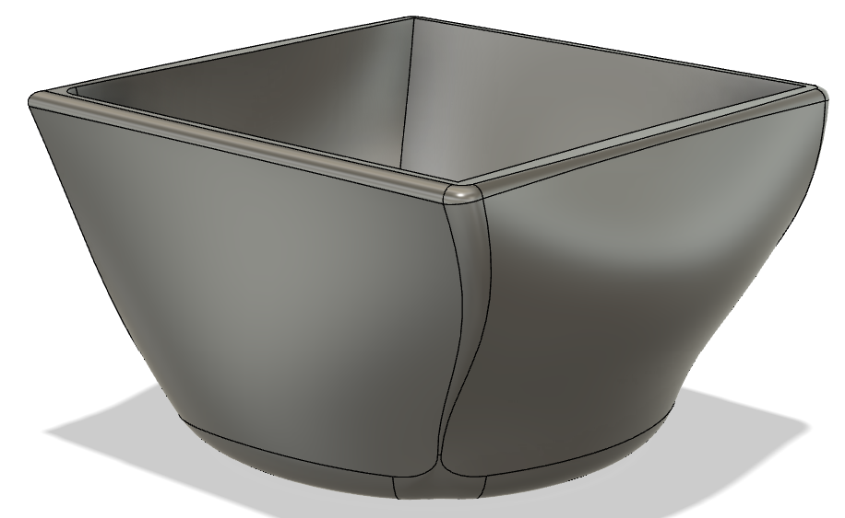
TOPIC 01 · HANDS-ON
Lab 3 — What You'll Work With
Reference — the model / setting you'll produce
Reference — as prepared in the slicer / tool
Innovating Product Development with 3D Printing and Additive · TGS-2022017597
© 2026 Tertiary Infotech Academy Pte Ltd
62

Slide 63
LAB 3 · VERIFY
Lab 3 — Loft — Mini Plant Pot with Custom Rails
✅ Test it
The pot prints support-free with an even 2.5 mm wall; the loft transition from circle to square is smooth with no layer separation.
Full steps and troubleshooting: Learner Guide · Lab 3
Innovating Product Development with 3D Printing and Additive · TGS-2022017597
© 2026 Tertiary Infotech Academy Pte Ltd
63

Slide 64
TOPIC 01 · HANDS-ON
Lab 4 — Revolve — Funnel from a 2D Profile
LAB 4
A1 — apply the revolve technique and choose a print orientation that avoids supports
Model a funnel in Fusion 360 by sketching its half cross-section and revolving it about the vertical axis, then invert it in Cura and 3D print it.
You'll build
A working funnel revolved from a single 2D profile, printed wide-end down.
Tools: Fusion 360, Ultimaker Cura, FDM printer (PLA)
Step-by-step guide: Learner Guide, Lab 4 · labs/lab-04 folder
Innovating Product Development with 3D Printing and Additive · TGS-2022017597
© 2026 Tertiary Infotech Academy Pte Ltd
64

Slide 65
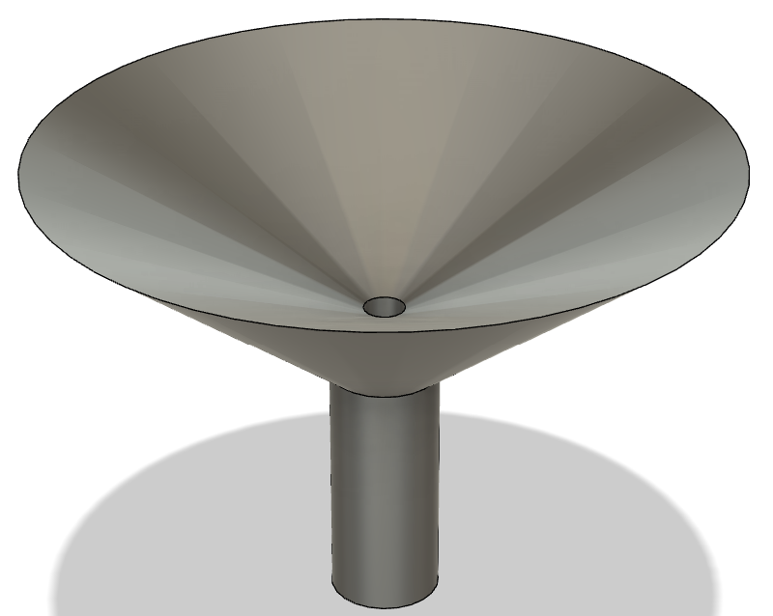
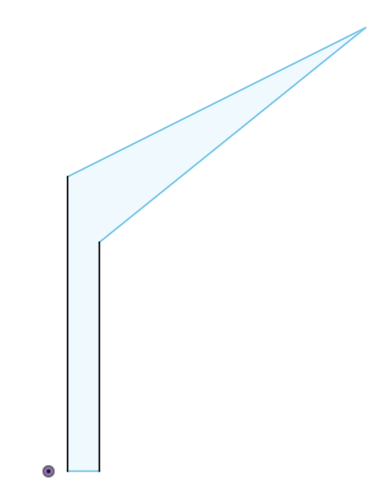
TOPIC 01 · HANDS-ON
Lab 4 — What You'll Work With
Reference — the model / setting you'll produce
Reference — as prepared in the slicer / tool
Innovating Product Development with 3D Printing and Additive · TGS-2022017597
© 2026 Tertiary Infotech Academy Pte Ltd
65

Slide 66
LAB 4 · VERIFY
Lab 4 — Revolve — Funnel from a 2D Profile
✅ Test it
Sliced upside-down the funnel needs no supports; water poured into the printed funnel flows cleanly through the spout.
Full steps and troubleshooting: Learner Guide · Lab 4
Innovating Product Development with 3D Printing and Additive · TGS-2022017597
© 2026 Tertiary Infotech Academy Pte Ltd
66

Slide 67
TOPIC 01 · HANDS-ON
Lab 5 — Tolerance — Container and Lid (0.2 mm Fit)
LAB 5
A1 — determine digital and physical tolerances between assembling parts
Model a container and lid as two separate bodies in Fusion 360 with a 0.2 mm clearance, verify the digital tolerance, then 3D print and test the physical fit.
You'll build
A two-part container whose lid slides on with a designed 0.2 mm clearance.
Tools: Fusion 360, Ultimaker Cura, FDM printer (PLA), digital calipers, supplied FDM Box reference files
Step-by-step guide: Learner Guide, Lab 5 · labs/lab-05 folder
Innovating Product Development with 3D Printing and Additive · TGS-2022017597
© 2026 Tertiary Infotech Academy Pte Ltd
67

Slide 68
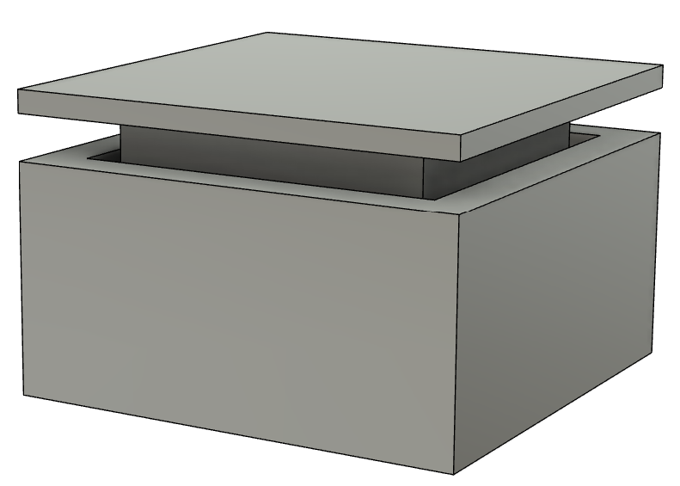
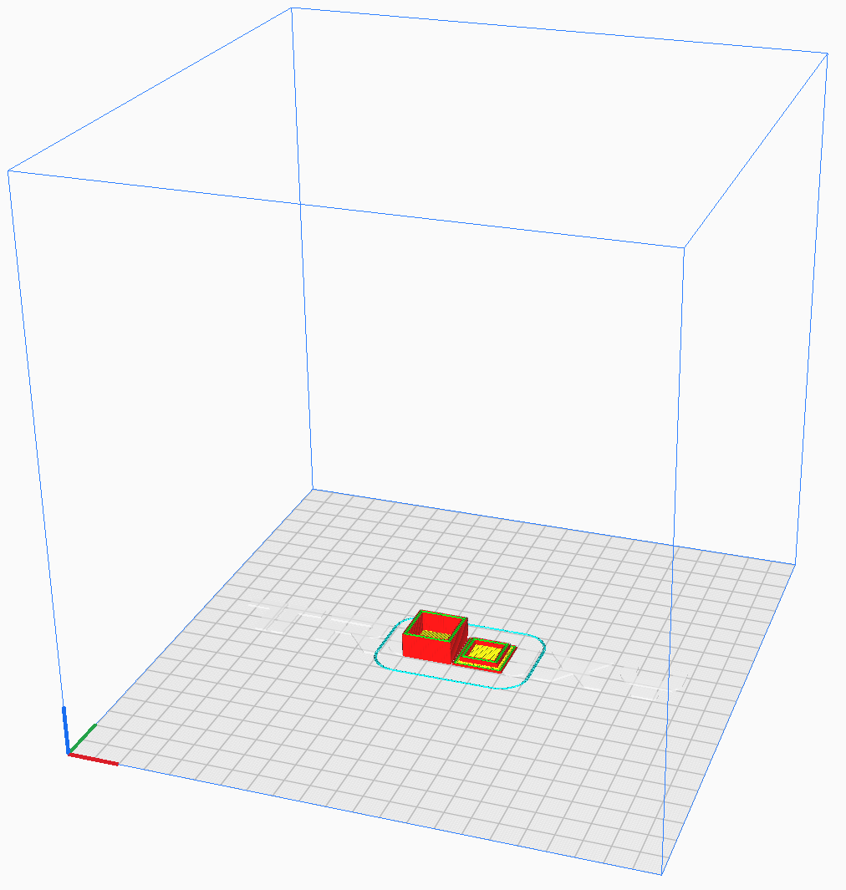
TOPIC 01 · HANDS-ON
Lab 5 — What You'll Work With
Reference — the model / setting you'll produce
Reference — as prepared in the slicer / tool
Innovating Product Development with 3D Printing and Additive · TGS-2022017597
© 2026 Tertiary Infotech Academy Pte Ltd
68

Slide 69
LAB 5 · VERIFY
Lab 5 — Tolerance — Container and Lid (0.2 mm Fit)
✅ Test it
The lid slides onto the container with light friction — neither loose nor forced — and your evidence distinguishes the designed 0.2 mm clearance, the measured printed result and the supplied FDM Box reference setup.
Full steps and troubleshooting: Learner Guide · Lab 5
Innovating Product Development with 3D Printing and Additive · TGS-2022017597
© 2026 Tertiary Infotech Academy Pte Ltd
69

Slide 70
TOPIC 01 · HANDS-ON
Lab 6 — 3D Scan and Print a Real Object
LAB 6
A4 — evaluate reverse engineering of a component through 3D scanning and subsequent AM
Scan a real object with a mobile 3D-scanning app, export the mesh as an STL file, repair it if needed, then slice and 3D print the reproduction.
You'll build
A 3D-printed reproduction of a real object captured by photogrammetry on your phone.
Tools: Polycam / Kiri Engine / Scandy Pro (mobile), Fusion 360, Ultimaker Cura
Step-by-step guide: Learner Guide, Lab 6 · labs/lab-06 folder
Innovating Product Development with 3D Printing and Additive · TGS-2022017597
© 2026 Tertiary Infotech Academy Pte Ltd
70

Slide 71
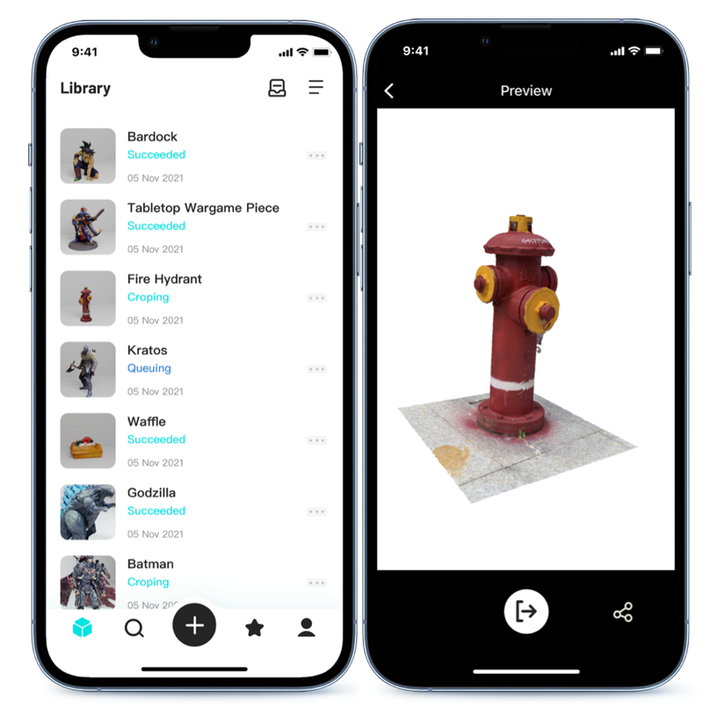
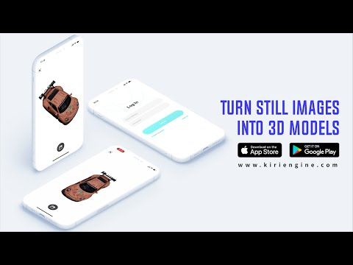
TOPIC 01 · HANDS-ON
Lab 6 — What You'll Work With
Reference — the model / setting you'll produce
Reference — as prepared in the slicer / tool
Innovating Product Development with 3D Printing and Additive · TGS-2022017597
© 2026 Tertiary Infotech Academy Pte Ltd
71

Slide 72
LAB 6 · VERIFY
Lab 6 — 3D Scan and Print a Real Object
✅ Test it
The exported STL loads into Cura as a watertight mesh, and the printed part is a recognisable scaled reproduction of the scanned object.
Full steps and troubleshooting: Learner Guide · Lab 6
Innovating Product Development with 3D Printing and Additive · TGS-2022017597
© 2026 Tertiary Infotech Academy Pte Ltd
72

Slide 73
TOPIC 01 · RECAP
Recap — Topic 1
• AM builds parts layer by layer from CAD with no part-specific tooling — seven process families cover polymers to metals.
• Material, complexity, volume, post-processing and cost drive the selection of an AM solution.
• AM's benefits (freedom, speed, customisation, low waste) trade against throughput, anisotropy and finishing.
• 3D scanning + Fusion 360 turn real objects into editable CAD for re-manufacture — reverse engineering.
• You modelled with extrude, sweep, loft and revolve, engineered a 0.2 mm fit, and printed a scanned object.
Innovating Product Development with 3D Printing and Additive · TGS-2022017597
© 2026 Tertiary Infotech Academy Pte Ltd
73

Slide 74
02
TOPIC 02
Process Related Issues for AM
Printer hardware · slicing · adhesion · extrusion · temperature · materials (K2, K4 · A2, A3)
Innovating Product Development with 3D Printing and Additive · TGS-2022017597
© 2026 Tertiary Infotech Academy Pte Ltd
74

Slide 75
FIVE SOURCES · K2
Where AM Issues Come From
Printer hardware
Frame, motion system, extruder, hotend, bed — wear and misalignment show up in every print.
Materials
Diameter variation, moisture, contamination and wrong temperature windows.
1
2
Printing process conditions
Speed, temperature, retraction, cooling and adhesion settings.
Environment conditions
Draughts, ambient temperature, humidity and vibration.
3
4
Design-caused
Overhangs, thin walls, sharp corners and tolerance choices that fight the process.
5
Innovating Product Development with 3D Printing and Additive · TGS-2022017597
© 2026 Tertiary Infotech Academy Pte Ltd
75

Slide 76
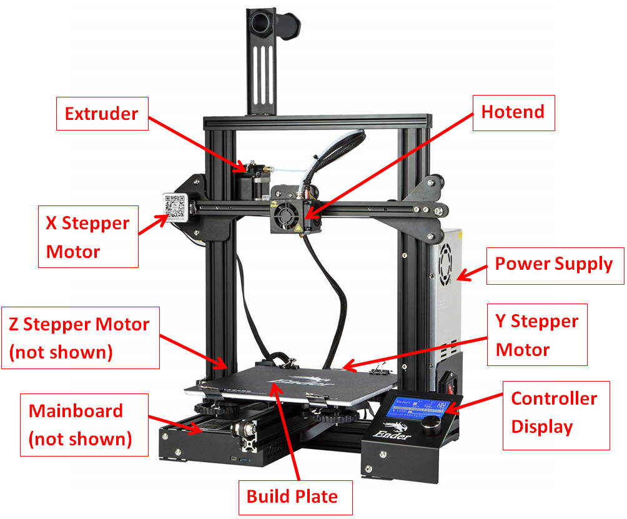
HARDWARE · K2
3D Printer Anatomy
Extruder · hotend · X/Y/Z steppers · build plate · power supply · mainboard · controller — know the part to diagnose the fault
Innovating Product Development with 3D Printing and Additive · TGS-2022017597
© 2026 Tertiary Infotech Academy Pte Ltd
76

Slide 77
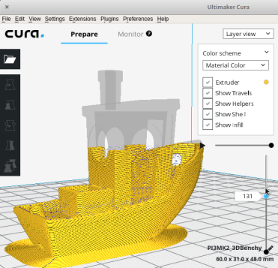
SOFTWARE · K2
The Slicer — From Mesh to G-code
What it does
Converts the 3D model (STL) into specific layer-by-layer instructions for the printer.
G-code
The output is G-code — movement, temperature and extrusion commands the printer executes.
Settings = quality
Every quality, speed and strength decision is made here, before the printer moves.
Cura
This course uses Ultimaker Cura — free, powerful, industry-standard for FDM.
Cura preparing a hull model — layer preview of the sliced toolpath. Alternatives: PrusaSlicer, SelfCAD, OctoPrint, IceSL, KISSlicer
Innovating Product Development with 3D Printing and Additive · TGS-2022017597
© 2026 Tertiary Infotech Academy Pte Ltd
77

Slide 78
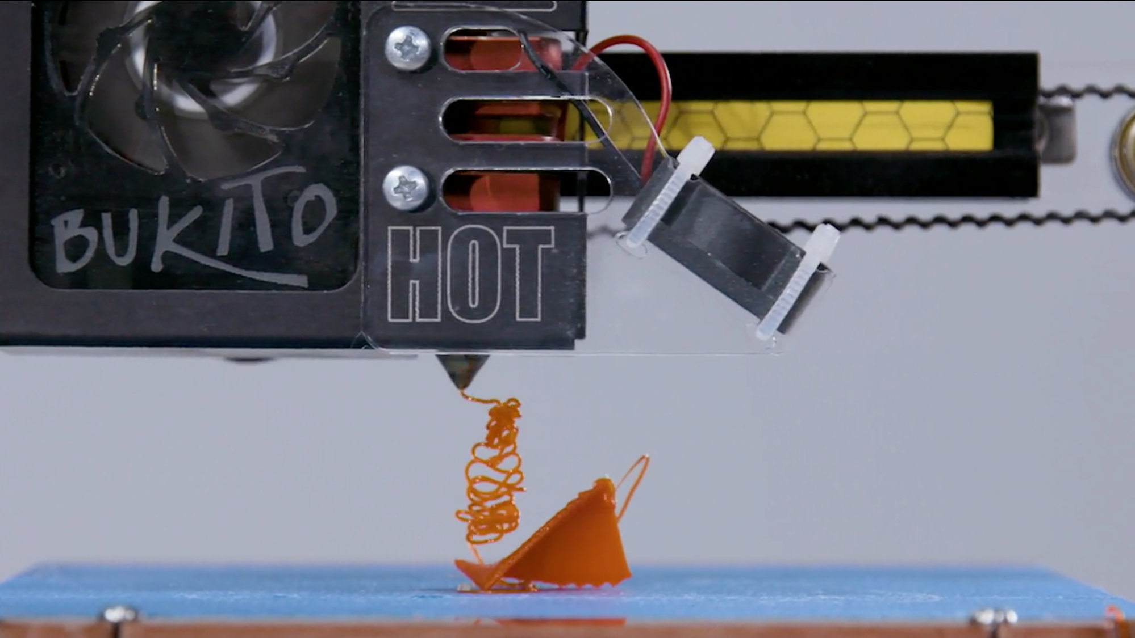
FIRST LAYER · K2/A2
Getting the Print to Stick
Print geometry
Small or complex bases have little contact area to grip the bed.
Nozzle distance
First-layer gap must be right — too far and nothing sticks, too close and it drags.
Platform surface
Bed material and films/coatings must be compatible with your filament.
Platform temperature
A heated bed keeps the first layers relaxed and attached.
An adhesion failure mid-print — the part broke loose and dragged
Innovating Product Development with 3D Printing and Additive · TGS-2022017597
© 2026 Tertiary Infotech Academy Pte Ltd
78

Slide 79
ADHESION AIDS · A2/A3 · LAB 8
Raft, Brim and Skirt
Raft
Brim
Skirt
• A printed grid platform the model sits on
• Rescues warping-prone and top-heavy parts
• Harder to remove; roughens the bottom face
• A flat border fused to the part's first-layer edge
• Boosts adhesion and fights warping
• Peels away; light cleanup at the edge
• Loops around the part, never touching it
• Primes the nozzle, evens the flow
• Doubles as a bed-levelling check
Innovating Product Development with 3D Printing and Additive · TGS-2022017597
© 2026 Tertiary Infotech Academy Pte Ltd
79

Slide 80
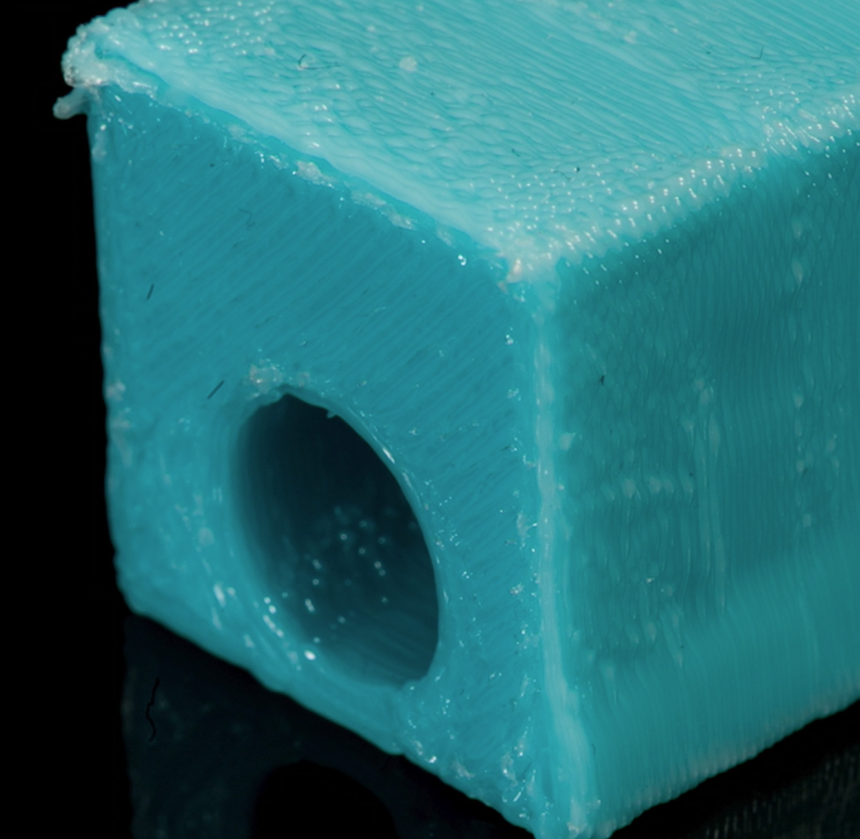
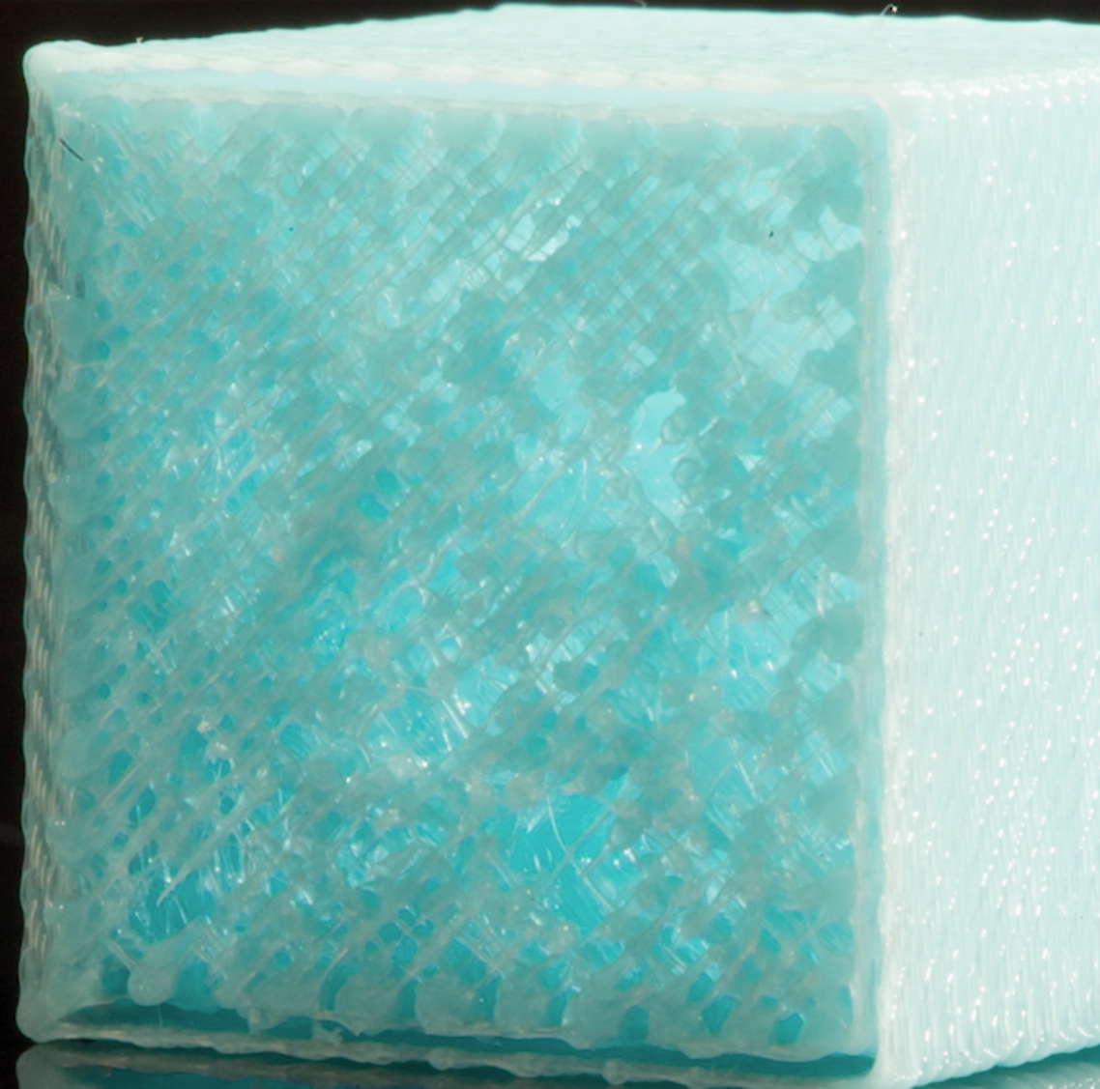
DIAGNOSIS · A2
Extrusion Issues — Over vs Under
Over-extrusion: blobby surfaces, oversized walls, ridged tops
Under-extrusion: gaps, thin walls, missing layers
Innovating Product Development with 3D Printing and Additive · TGS-2022017597
© 2026 Tertiary Infotech Academy Pte Ltd
80

Slide 81
A2/A3 · CAUSE → FIX
Diagnosing Extrusion Faults
Too much
Too little
• Over-extrusion — too much plastic
– Blobby prints; holes come out undersized
– Ridges stick up from top surfaces
– Fix: calibrate flow %, check filament diameter
– Fix: lower temperature a step
• Under-extrusion — too little plastic
– Gaps between lines; weak, brittle layers
– Extruder clicking or grinding the filament
– Fix: check for partial clogs and jam points
– Fix: raise temperature / slow down / dry filament
Innovating Product Development with 3D Printing and Additive · TGS-2022017597
© 2026 Tertiary Infotech Academy Pte Ltd
81

Slide 82
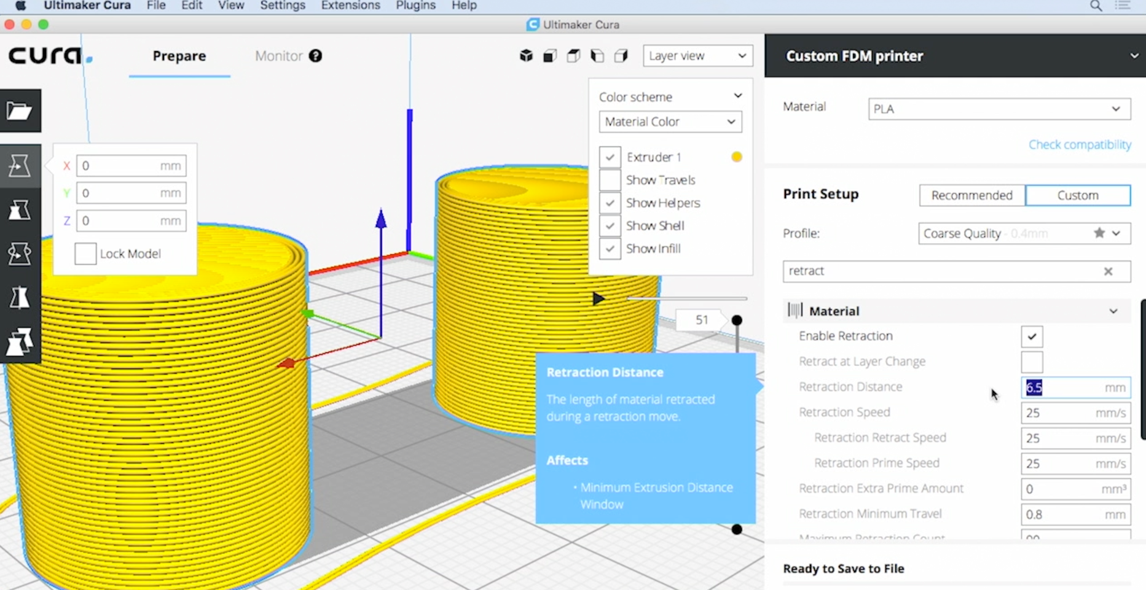
A2 · RETRACTION
Retraction — Stopping the Flow
Why retract
Plastic in the nozzle is under pressure; jumps across open space would leak.
The move
The extruder pulls filament back a few millimetres to equalise pressure.
Distance & speed
Tuned per printer/material — Bowden setups need more than direct drive.
Get it wrong
Too little → oozing and strings; too much → dimples and jams.
Cura retraction settings — distance and speed
Innovating Product Development with 3D Printing and Additive · TGS-2022017597
© 2026 Tertiary Infotech Academy Pte Ltd
82

Slide 83
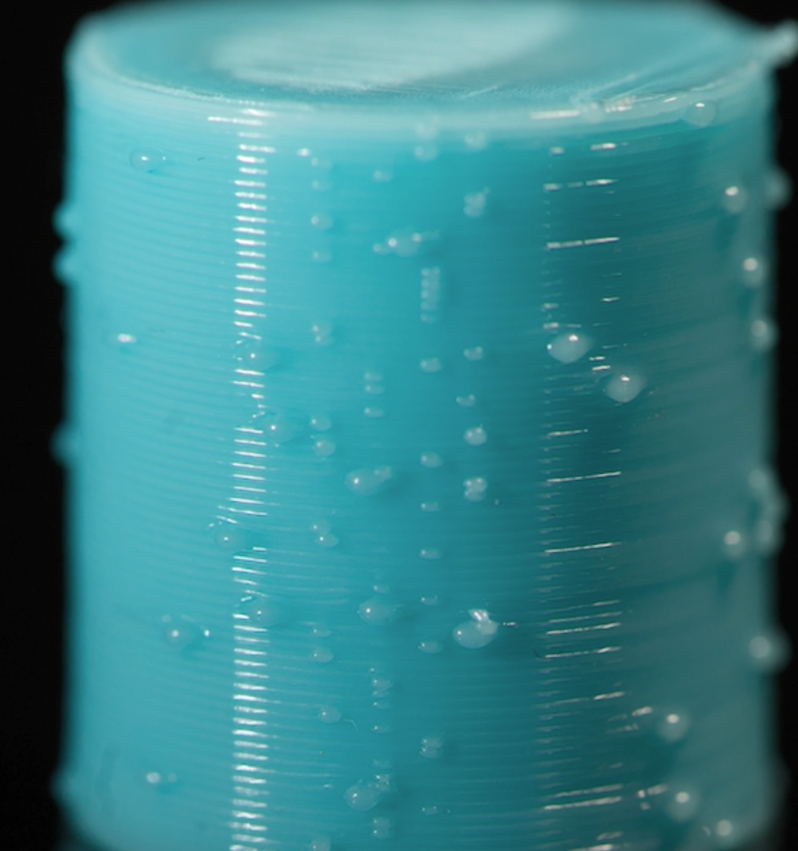
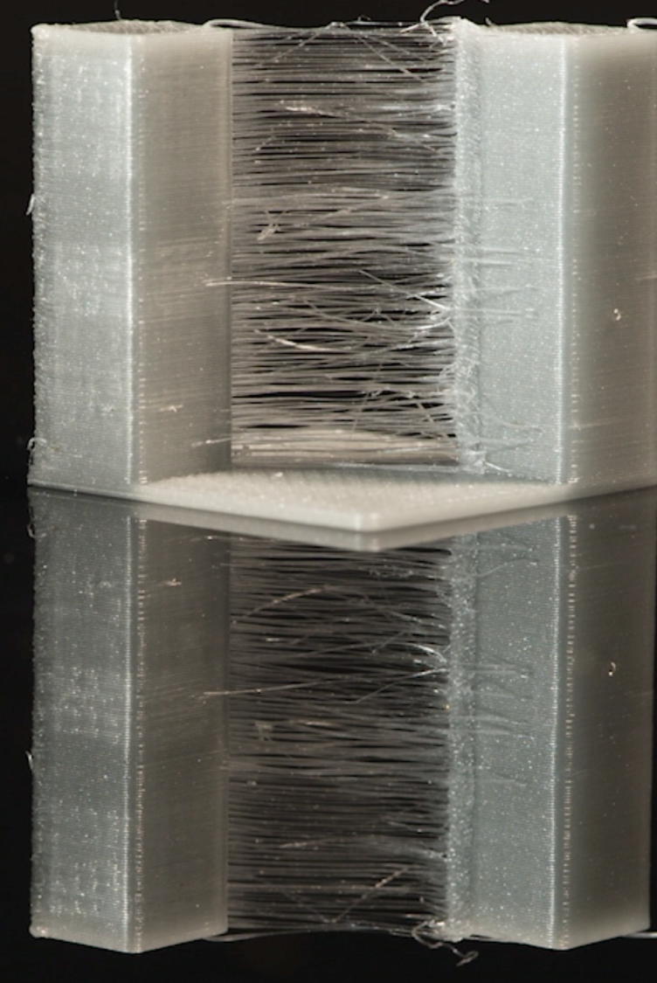
A2 · SYMPTOMS
Oozing and Stringing
Blobs and dimples where pressure equalised badly
Strings bridge the travel moves between towers
Innovating Product Development with 3D Printing and Additive · TGS-2022017597
© 2026 Tertiary Infotech Academy Pte Ltd
83

Slide 84
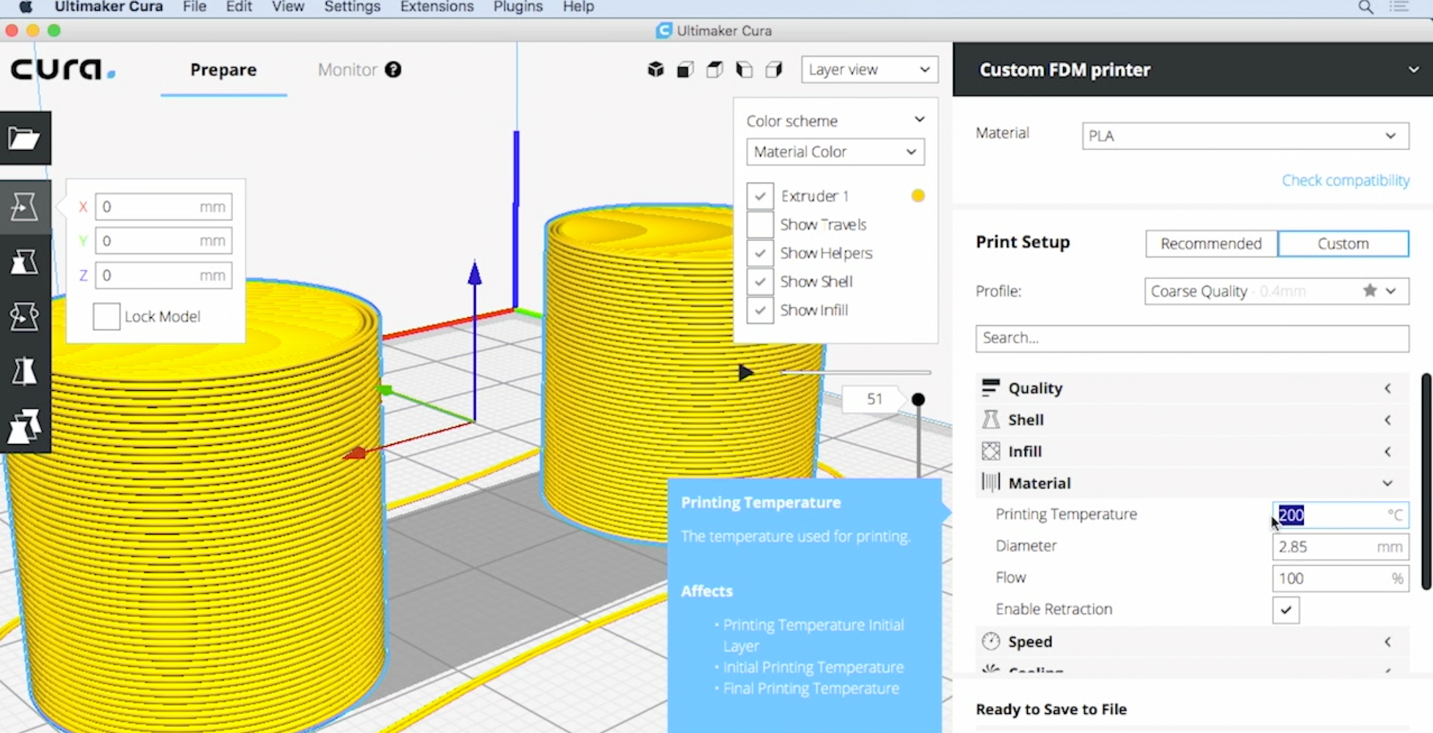
A2 · TEMPERATURE
Temperature — The Master Variable
Too low — way
Extrusion fails: clicking extruder, ground filament, nothing flows.
Too low — slightly
Layers don't bond; the part delaminates along layer lines.
Too high — slightly
Bridges and overhangs sag; stringing hard to control.
Too high — way
Smoking, discolouration, dripping liquid instead of controlled extrusion.
Setting printing temperature in Cura's material section
Innovating Product Development with 3D Printing and Additive · TGS-2022017597
© 2026 Tertiary Infotech Academy Pte Ltd
84

Slide 85
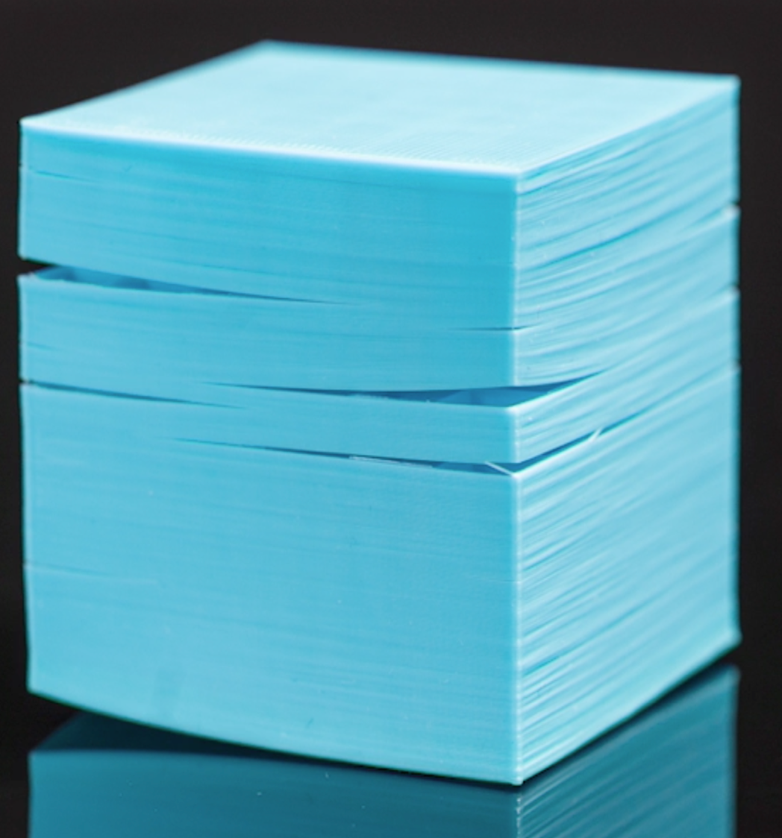
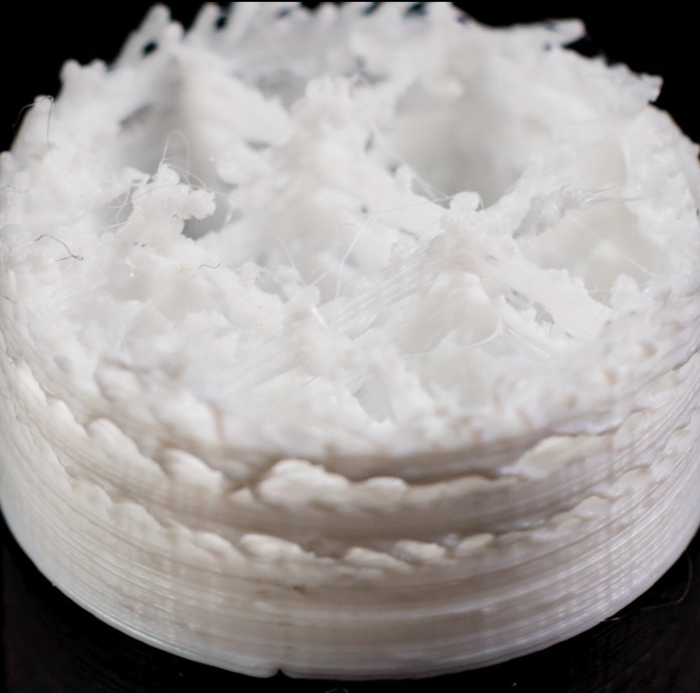
A2 · EVIDENCE
Reading Temperature Faults
Bonding too cold — layers separate under light force
Far too hot — sagging, melted detail, discolouration
Innovating Product Development with 3D Printing and Additive · TGS-2022017597
© 2026 Tertiary Infotech Academy Pte Ltd
85

Slide 86
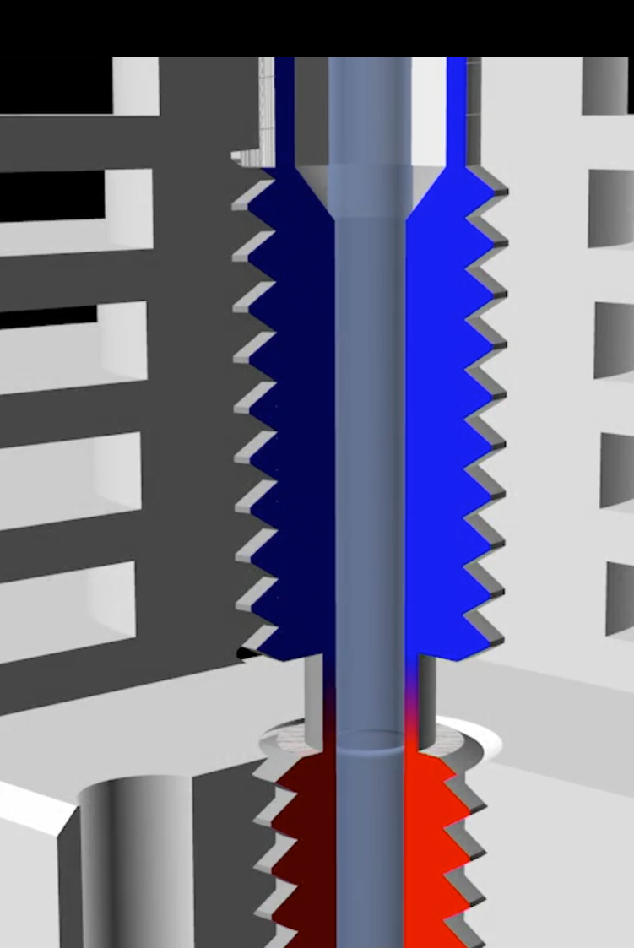
A2 · JAMS
Filament Jams and Heat Creep
The jam
Nozzle moves, nothing extrudes — clicking as the motor skips backwards.
Heat creep
Heat spreads up the filament path; filament swells and binds before the melt zone.
PLA is fragile here
PLA's low glass point makes it the most heat-creep-prone material.
Prevention
Cooling fan on the heatbreak, retraction not overtuned, quality filament.
Heat creep: the melt zone (red) spreading up the cold side
Innovating Product Development with 3D Printing and Additive · TGS-2022017597
© 2026 Tertiary Infotech Academy Pte Ltd
86

Slide 87
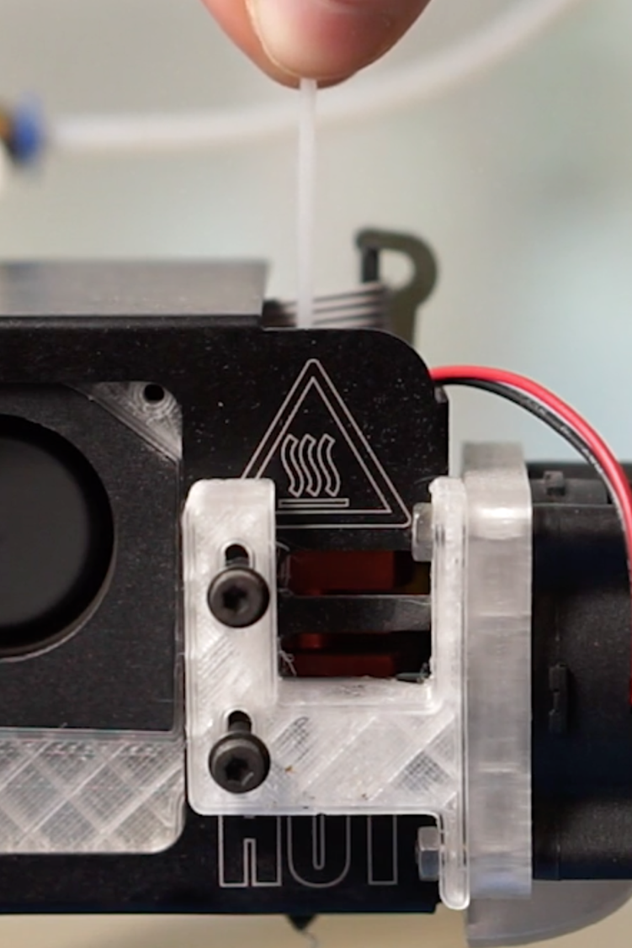
A3 · PROCEDURE
Clearing a Clogged Nozzle
Hot needle
Heat the nozzle, insert a needle/wire held with pliers — never fingers.
Gentle pressure
Poke the clog while pressing the filament lightly from above.
Cold pull
Once flowing, cool slightly and yank the filament to extract residue.
Persistent clogs
Swap the nozzle — they are consumables, not heirlooms.
Clearing a clog with a needle — hot end, pliers, patience
Innovating Product Development with 3D Printing and Additive · TGS-2022017597
© 2026 Tertiary Infotech Academy Pte Ltd
87

Slide 88
MATERIALS · K2
The Filament Universe
Standards
PLA · ABS · PETG/PET · Nylon — the four you must know (next slides).
Flexibles
TPE / TPU — rubber-like parts, gaskets, tyres.
1
2
Composites
Carbon-fibre, wood, sandstone, metal-filled — stiffness or looks.
Soluble
PVA (water) and HIPS (limonene) — dissolvable support materials.
3
4
Functional
Conductive, magnetic iron, glow-in-the-dark, Amphora.
Engineering
PC, PEEK, ULTEM — high temperature, high strength, high difficulty.
5
6
Innovating Product Development with 3D Printing and Additive · TGS-2022017597
© 2026 Tertiary Infotech Academy Pte Ltd
88

Slide 89
K2 · MATERIALS HEAD-TO-HEAD
ABS vs PLA
ABS
PLA
• ABS — engineering workhorse
– Durable, strong, lightweight and slightly flexible
– Cheap and proven — the professional's default for years
– Petroleum-based, not biodegradable
– High temperatures; warps without heated bed/enclosure
– Unpleasant fumes — ventilate the room
• PLA — the friendly starter
– Plant-derived; sweet smell, no harsh fumes
– Easy to print, minimal warping — ideal for beginners
– Huge colour/effect range: glow, translucent, silk
– Brittle vs ABS; softens in a hot car
– Attracts moisture — store dry
Innovating Product Development with 3D Printing and Additive · TGS-2022017597
© 2026 Tertiary Infotech Academy Pte Ltd
89

Slide 90
K2 · MATERIALS HEAD-TO-HEAD
PETG vs Nylon
PETG
Nylon
• PETG — tough all-rounder
– Strong, flexible, water- and chemical-resistant
– Low warp, low shrink; food-safe grades exist
– Doesn't absorb moisture from the air readily
– Needs fine-tuned nozzle & bed temperatures
– Strings more than PLA while tuning
• Nylon — engineering flexibility
– Strong, durable and flexible; less brittle than ABS/PLA
– 100% thermoplastic — re-meltable without bond loss
– High melting temperature required
– Emits fumes when overheated — ventilate
– Extremely hygroscopic — dry-box storage essential
Innovating Product Development with 3D Printing and Additive · TGS-2022017597
© 2026 Tertiary Infotech Academy Pte Ltd
90

Slide 91
K2 · THE WINDOWS
Required Temperatures by Material
Material
Extruder
Bed
PLA
195–215 °C
Room temp or 60 °C
PETG
240–260 °C
Room temp small parts, or 80–90 °C
Nylon
240–260 °C
Room temp, but needs special platforms
ABS
240–260 °C
110–120 °C
Polycarbonate
280–300 °C
130 °C+
Start mid-window; tune in 5 °C steps — strings mean too hot, poor bonding means too cold (Lab 10).
Innovating Product Development with 3D Printing and Additive · TGS-2022017597
© 2026 Tertiary Infotech Academy Pte Ltd
91

Slide 92
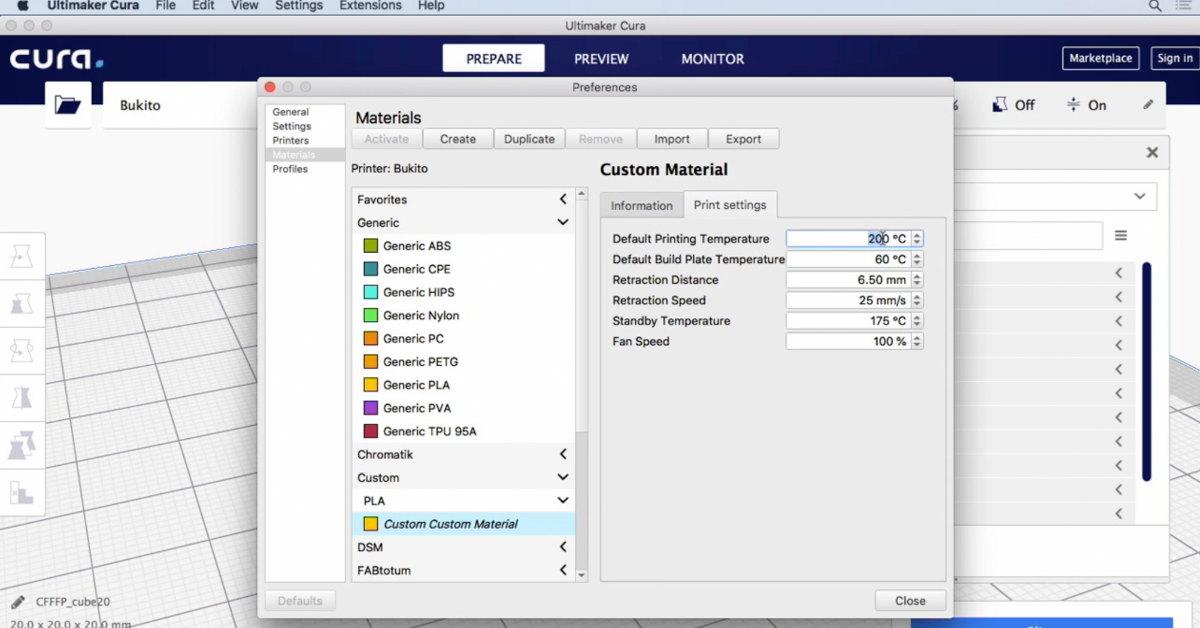
K2 · CONFIGURATION
Material Settings in Cura
Material definition
Temperature, fan and flow defaults come from the material profile.
Settings override
A value set in Print Settings beats the material definition for that print.
Profiles persist
Create/update a profile to make your tuned overrides permanent.
One source of truth
Keep tuned profiles per material — the end of guesswork.
Cura material management — the definition your prints inherit
Innovating Product Development with 3D Printing and Additive · TGS-2022017597
© 2026 Tertiary Infotech Academy Pte Ltd
92

Slide 93
A3 · MIXED MATERIALS
Hybrid Metal + Non-Metal Components
1
2
3
4
5
▶
▶
▶
▶
SPLIT — separate the design into metallic and non-metallic parts
SELECT — DMLS/SLM for metals; FDM/SLS for polymers
POST-PROCESS — apply each material's finishing chain separately
BOND — join with the right technique, e.g. electroless deposition
VERIFY — test the assembly's integrity as one component
Innovating Product Development with 3D Printing and Additive · TGS-2022017597
© 2026 Tertiary Infotech Academy Pte Ltd
93

Slide 94
WHAT YOU'LL DO · LABS 7–10
Hands-On Labs — Topic 2
Toolchain
Adhesion & support
Materials
• Lab 7: Install Cura
• Slice your first model
• Read the G-code preview
• Lab 8: Skirt vs brim vs raft
• Lab 9: Supports for overhangs
• Lab 10: Filament diagnostics
• Diameter, temperature, flow
Innovating Product Development with 3D Printing and Additive · TGS-2022017597
© 2026 Tertiary Infotech Academy Pte Ltd
94

Slide 95
TOPIC 02 · HANDS-ON
Lab 7 — Install Cura and Slice Your First Model
LAB 7
A2 — set up the slicing toolchain used to analyse and fix AM process issues
Install Ultimaker Cura, add your printer profile, and slice a calibration cube to understand how the slicer turns an STL into G-code printer instructions.
You'll build
A working Cura installation with your printer profile, and your first sliced G-code file.
Tools: Ultimaker Cura, cube10.stl, cube20.stl
Step-by-step guide: Learner Guide, Lab 7 · labs/lab-07 folder
Innovating Product Development with 3D Printing and Additive · TGS-2022017597
© 2026 Tertiary Infotech Academy Pte Ltd
95

Slide 96
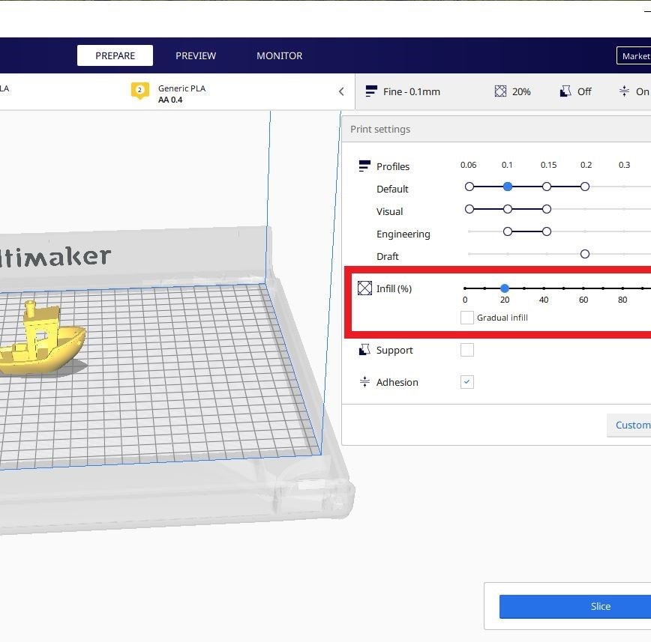
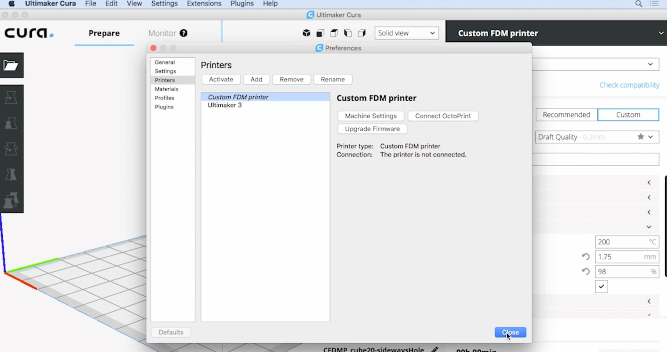
TOPIC 02 · HANDS-ON
Lab 7 — What You'll Work With
Reference — the model / setting you'll produce
Reference — as prepared in the slicer / tool
Innovating Product Development with 3D Printing and Additive · TGS-2022017597
© 2026 Tertiary Infotech Academy Pte Ltd
96

Slide 97
LAB 7 · VERIFY
Lab 7 — Install Cura and Slice Your First Model
✅ Test it
Cura shows per-layer toolpaths for both cubes, cube20.stl measures 20 × 20 × 20 mm, and your comparison explains why doubling linear size increases print time and material by much more than two times.
Full steps and troubleshooting: Learner Guide · Lab 7
Innovating Product Development with 3D Printing and Additive · TGS-2022017597
© 2026 Tertiary Infotech Academy Pte Ltd
97

Slide 98
TOPIC 02 · HANDS-ON
Lab 8 — Bed Adhesion — Skirt vs Brim vs Raft
LAB 8
A2 — analyse first-layer adhesion issues and select the correct adhesion aid
Slice three instances of the same cube with a skirt, a brim and a raft, print them, and compare adhesion strength, removal effort and bottom-surface finish.
You'll build
Three prints of cube10.stl demonstrating skirt, brim and raft — and a rule for when to use each.
Tools: Ultimaker Cura, cube10.stl, FDM printer
Step-by-step guide: Learner Guide, Lab 8 · labs/lab-08 folder
Innovating Product Development with 3D Printing and Additive · TGS-2022017597
© 2026 Tertiary Infotech Academy Pte Ltd
98

Slide 99
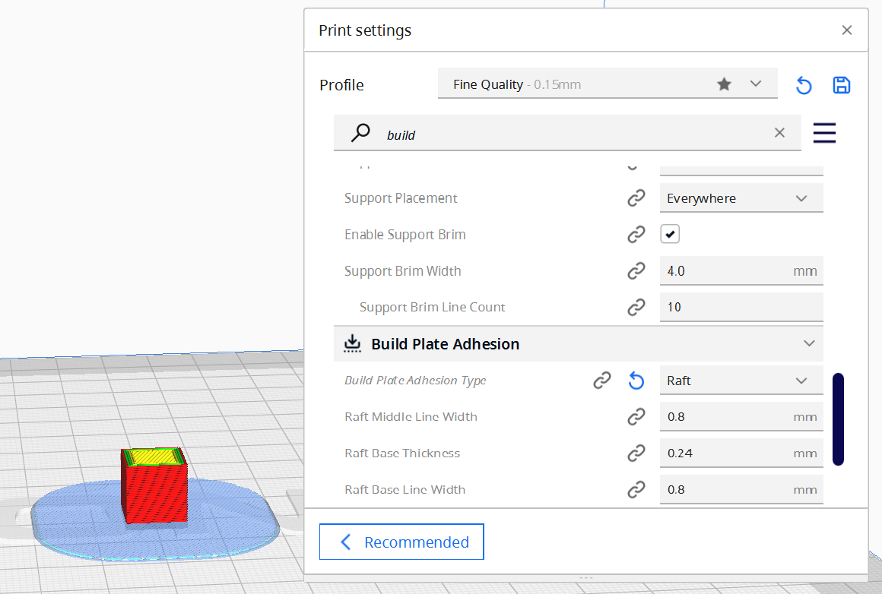
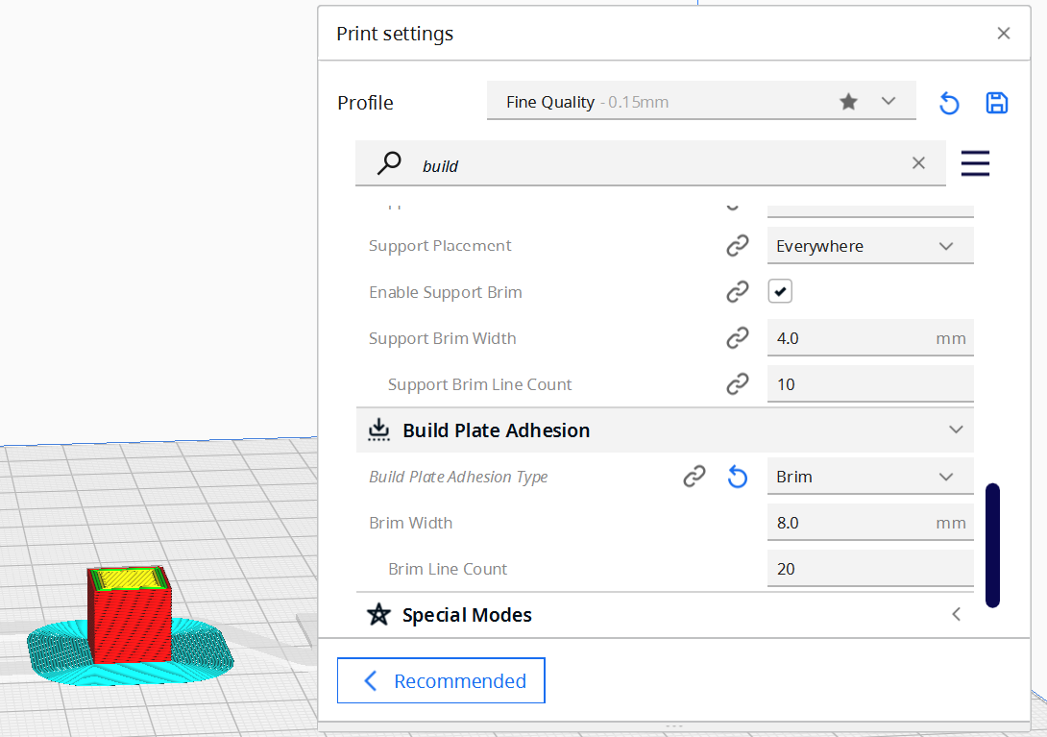
TOPIC 02 · HANDS-ON
Lab 8 — What You'll Work With
Reference — the model / setting you'll produce
Reference — as prepared in the slicer / tool
Innovating Product Development with 3D Printing and Additive · TGS-2022017597
© 2026 Tertiary Infotech Academy Pte Ltd
99

Slide 100
LAB 8 · VERIFY
Lab 8 — Bed Adhesion — Skirt vs Brim vs Raft
✅ Test it
You can state when each aid applies — skirt to prime the nozzle, brim for warping-prone or small-footprint parts, raft for top-heavy or poorly adhering parts — and show the bottom-finish difference.
Full steps and troubleshooting: Learner Guide · Lab 8
Innovating Product Development with 3D Printing and Additive · TGS-2022017597
© 2026 Tertiary Infotech Academy Pte Ltd
100

Slide 101
TOPIC 02 · HANDS-ON
Lab 9 — Support Structures for Overhangs
LAB 9
A2, A3 — determine when overhang geometry requires supports and generate them
Use supplied twist, wedge and sideways-hole models to identify unsupported islands, compare orientation choices, then generate only the supports the geometry needs.
You'll build
A support decision sheet plus a printed Twisted Solid whose critical overhangs succeed with controlled support use.
Tools: Ultimaker Cura, Twisted-Solid.stl, wedge.stl, cube20-sideways-hole.stl, FDM printer
Step-by-step guide: Learner Guide, Lab 9 · labs/lab-09 folder
Innovating Product Development with 3D Printing and Additive · TGS-2022017597
© 2026 Tertiary Infotech Academy Pte Ltd
101

Slide 102
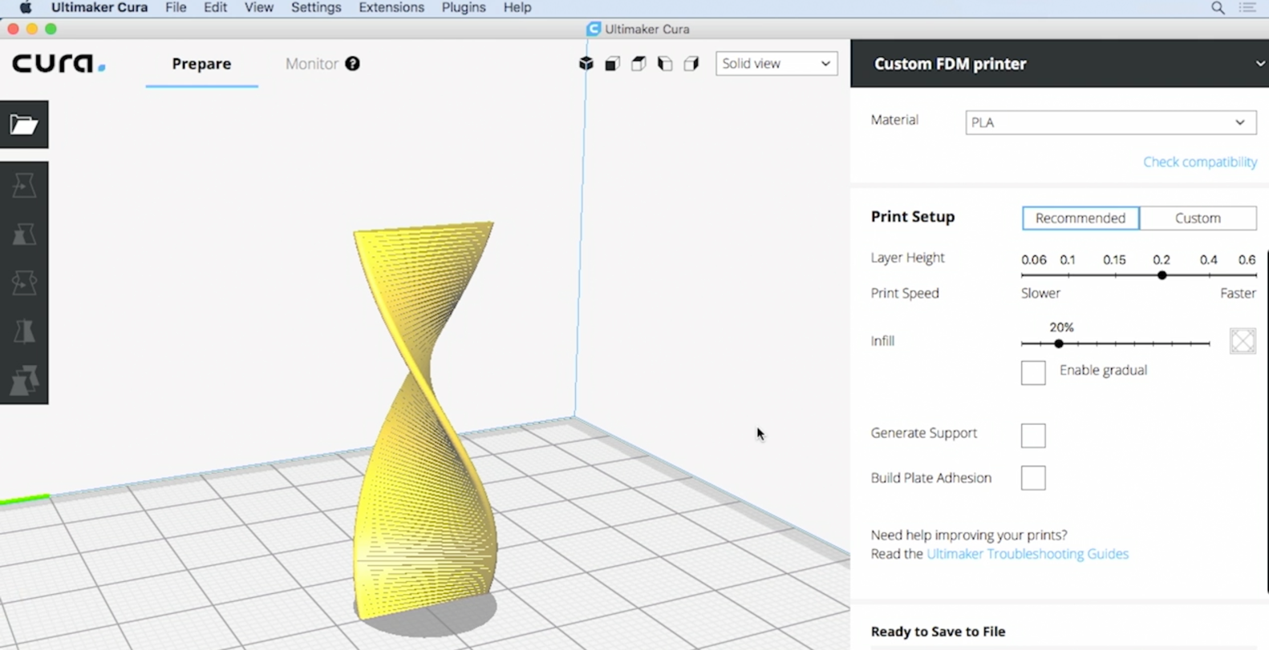
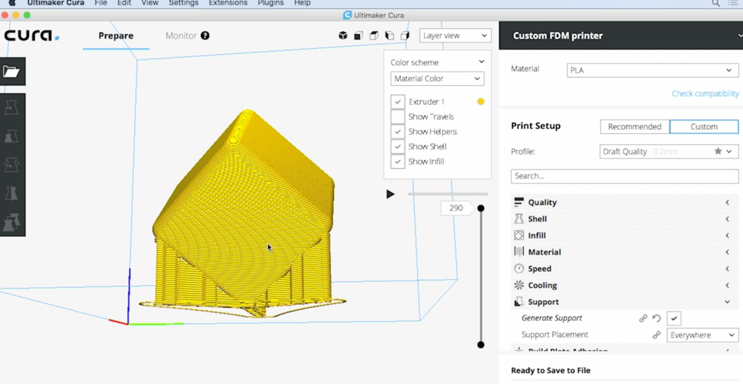
TOPIC 02 · HANDS-ON
Lab 9 — What You'll Work With
Reference — the model / setting you'll produce
Reference — as prepared in the slicer / tool
Innovating Product Development with 3D Printing and Additive · TGS-2022017597
© 2026 Tertiary Infotech Academy Pte Ltd
102

Slide 103
LAB 9 · VERIFY
Lab 9 — Support Structures for Overhangs
✅ Test it
Your decision table correctly identifies unsupported islands and distinguishes when support is necessary from when reorientation is the better fix; the Twisted Solid print completes with removable support and only minor underside scarring.
Full steps and troubleshooting: Learner Guide · Lab 9
Innovating Product Development with 3D Printing and Additive · TGS-2022017597
© 2026 Tertiary Infotech Academy Pte Ltd
103

Slide 104
TOPIC 02 · HANDS-ON
Lab 10 — Filament Diagnostics — Diameter, Temperature and Flow
LAB 10
A2, A3 — analyse material-side causes of extrusion issues and verify filament quality
Measure filament diameter with digital calipers, verify it against the slicer's material setting, and run a temperature check to place your filament in its working window.
You'll build
A verified filament profile plus retraction and cooling evidence from purpose-built diagnostic models.
Tools: Digital calipers, filament spool (PLA/ABS/PETG), Ultimaker Cura, retraction-test.stl, cooling-spire.stl, FDM printer
Step-by-step guide: Learner Guide, Lab 10 · labs/lab-10 folder
Innovating Product Development with 3D Printing and Additive · TGS-2022017597
© 2026 Tertiary Infotech Academy Pte Ltd
104

Slide 105


TOPIC 02 · HANDS-ON
Lab 10 — What You'll Work With
Reference — the model / setting you'll produce
Reference — as prepared in the slicer / tool
Innovating Product Development with 3D Printing and Additive · TGS-2022017597
© 2026 Tertiary Infotech Academy Pte Ltd
105

Slide 106
LAB 10 · VERIFY
Lab 10 — Filament Diagnostics — Diameter, Temperature and Flow
✅ Test it
Your diameter average is within ±0.05 mm of nominal, Cura carries the measured value, and the diagnostic models support a retraction/cooling choice with less stringing and a cleaner spire without introducing gaps or jams.
Full steps and troubleshooting: Learner Guide · Lab 10
Innovating Product Development with 3D Printing and Additive · TGS-2022017597
© 2026 Tertiary Infotech Academy Pte Ltd
106

Slide 107
TOPIC 02 · RECAP
Recap — Topic 2
• AM issues trace to five sources: hardware, materials, process conditions, environment and design.
• The slicer converts STL to G-code — adhesion aids (skirt/brim/raft) and supports are slicing decisions.
• Extrusion faults, retraction, oozing, jams and heat creep are diagnosed from the printed evidence.
• Each material demands its temperature window, bed and storage — verified, not assumed (Lab 10).
• Hybrid metal/polymer components pair the right AM process per part with the right bonding technique.
Innovating Product Development with 3D Printing and Additive · TGS-2022017597
© 2026 Tertiary Infotech Academy Pte Ltd
107

Slide 108
03
TOPIC 03
Process Improvement for AM
Infill · surface quality · supports · post-processing · business impact (K5, K7 · A5, A6)
Innovating Product Development with 3D Printing and Additive · TGS-2022017597
© 2026 Tertiary Infotech Academy Pte Ltd
108

Slide 109

A5 · STRUCTURE
Infill and Perimeters
Perimeter (walls)
The solid outline around each layer — walls carry most of a part's strength.
Infill
The internal lattice — typically only 15–20% of the enclosed volume.
The dial
More walls/infill: stronger, heavier, slower. Less: faster, lighter, weaker.
Lab 11
You'll measure exactly what each setting costs in time and grams.
Cura print settings — walls and infill density
Innovating Product Development with 3D Printing and Additive · TGS-2022017597
© 2026 Tertiary Infotech Academy Pte Ltd
109

Slide 110

A5 · TUNING
Infill — Density and Pattern Effects
12–20% typical
Fraction of the interior that is plastic — the default band for most parts.
50%+ for strength
Functional, loaded parts justify denser infill and less warping.
Pattern matters
Grid, zigzag, gyroid, cubic — each trades strength direction vs speed.
Lab 12
Zigzag 20% vs grid 30% — printed and squeezed side by side.
Infill preview at increasing densities
Innovating Product Development with 3D Printing and Additive · TGS-2022017597
© 2026 Tertiary Infotech Academy Pte Ltd
110

Slide 111

A5 · RESOLUTION
Surface Quality — Layer Height
The resolution dial
Layer height sets the visible stair-step on every curved or sloped face.
Time trade
0.1 mm looks superb and takes twice as long as 0.2 mm; 0.3 mm is draft mode.
Top thickness follows
Keep top THICKNESS constant so the layer count adapts — Lab 13.
Match to purpose
Draft iterations coarse; presentation parts fine.
Layer-height setting drives finish and duration
Innovating Product Development with 3D Printing and Additive · TGS-2022017597
© 2026 Tertiary Infotech Academy Pte Ltd
111

Slide 112

A5 · ROOFS
The Top Layer — Pillowing
Preview lies
The simulated top looks flat; physics prints it over air gaps.
Pillowing
Thin roofs sag between infill lines, or curl and break — bumpy tops.
Fixes
More top layers, denser infill under roofs, better cooling.
Rule of thumb
Top thickness ≥ 4× layer height for a clean roof.
Pillowing: the roof sags into sparse infill
Innovating Product Development with 3D Printing and Additive · TGS-2022017597
© 2026 Tertiary Infotech Academy Pte Ltd
112

Slide 113

A5 · FINISH
Surface Texture Options
Build surface finish
Glossy or textured bottom faces — decided by the bed surface itself.
Ironing — Lab 14
The hot nozzle re-passes top faces at ~10% flow for glass-smooth roofs.
Fuzzy skin — Lab 15
Random jitter on outer walls hides layer lines behind texture.
Deliberate design
Texture is a slicing decision, not an accident.
Surface finish elevates a print into a product
Innovating Product Development with 3D Printing and Additive · TGS-2022017597
© 2026 Tertiary Infotech Academy Pte Ltd
113

Slide 114

A5 · SUPPORTS
Support Strategy
Overhangs need support
Anything printing into free space beyond ~45–50° needs scaffolding.
Reorient first
Rotating the part is free — supports cost material, time and finish.
Placement control
Touching-buildplate vs everywhere; blockers protect chosen faces.
Removal is a cost
Every support leaves a scar — plan removal before slicing (Lab 16).
Cura support generation — angle and placement settings
Innovating Product Development with 3D Printing and Additive · TGS-2022017597
© 2026 Tertiary Infotech Academy Pte Ltd
114

Slide 115

A5 · JUDGEMENT
Support Challenges
Inaccessible cavities
Supports inside holes and channels may be impossible to extract.
Skip or limit
Sometimes the right call is limiting supports and accepting minor sag.
Design around it
Chamfer the overhang, bridge the gap, or split the part for printing.
The craft
Support judgement separates operators from process engineers.
A part whose internal void must stay support-free
Innovating Product Development with 3D Printing and Additive · TGS-2022017597
© 2026 Tertiary Infotech Academy Pte Ltd
115

Slide 116
K5/K6 · TECHNOLOGY REVIEW
Pros and Cons — SLS & Inkjet-Style AM
Powder + laser
Droplets + binder
• SLS
– No supports — powder holds the part
– Tough, functional nylon parts; batch nesting
– Grainy surface; powder handling & recycling
– Long cool-down before parts emerge
• Material/Binder jetting
– Multi-material and full-colour capability
– Fine features, smooth surfaces
– Fragile green parts (binder); resin cost
– Nozzle clogging and layer misalignment risks
Innovating Product Development with 3D Printing and Additive · TGS-2022017597
© 2026 Tertiary Infotech Academy Pte Ltd
116

Slide 117
K5/K6 · METAL REVIEW
Pros and Cons — DMLS & SLM
Sinter
Melt
• DMLS — sintered metal
– Complex metal geometries, good strength
– Established in dental & aerospace
– Warping from rapid cooling; powder inconsistency
– Expensive machines and powders
• SLM — fully melted metal
– Full density, best mechanical properties
– Single-alloy purity
– Oxidation risk — inert atmosphere required
– High residual stresses — heat treatment mandatory
Innovating Product Development with 3D Printing and Additive · TGS-2022017597
© 2026 Tertiary Infotech Academy Pte Ltd
117

Slide 118
K5 · MEASURE THE IMPACT · A5
Business Considerations for AM Operations
Production speed
Compare cycle times before and after every process change.
Quality
Functionality, mechanical properties, dimensional accuracy, surface finish.
1
2
Material usage
Consumption and wastage — supports, purge, failed prints.
Resource utilisation
Machine uptime, operator hours, floor space, energy.
3
4
Cost & savings
Full cost delta of the change, capital to consumables.
Ease of use & feedback
Operator experience and the challenges users report.
5
6
Innovating Product Development with 3D Printing and Additive · TGS-2022017597
© 2026 Tertiary Infotech Academy Pte Ltd
118

Slide 119
K5 · THE LOOP
Assessing a Process Improvement
1
2
3
4
5
▶
▶
▶
▶
BASELINE — record speed, quality, material and cost before
CHANGE — introduce one improvement at a time
MEASURE — same metrics, same parts, after
COMPARE — quantify the delta; collect operator feedback
DECIDE — adopt, tune or roll back; document the standard
Innovating Product Development with 3D Printing and Additive · TGS-2022017597
© 2026 Tertiary Infotech Academy Pte Ltd
119

Slide 120
K7 · SUSTAINABILITY
Sustaining AM Operations Long-Term
Calibration & maintenance
Regular calibration and preventive maintenance of AM equipment.
People
Continuous training and education of AM personnel.
1
2
Materials R&D
Ongoing research into sustainable, environmentally-friendly materials.
Collaboration
Work with stakeholders on sustainability standards and best practices.
3
4
Circularity
Recycle powders and failed prints; design for material recovery.
Knowledge base
Document tuned profiles and fixes — institutional memory compounds.
5
6
Innovating Product Development with 3D Printing and Additive · TGS-2022017597
© 2026 Tertiary Infotech Academy Pte Ltd
120

Slide 121
A5 · FINISHING FDM
Post-Processing — FDM
Support removal
Manual removal with tools, or dissolve PVA in water / HIPS in limonene.
Filling & sanding
Epoxy fillers close gaps; progressive grits smooth surfaces (Lab 16).
1
2
Vapour smoothing & dipping
Solvent vapour or acetone dip melts the surface to a gloss.
Priming & painting
Primer then paint for presentation parts.
3
4
Coating
Epoxy resin coats add a protective, sealed skin.
Metal plating
Chemical or electro-plating gives polymer parts a metallic finish.
5
6
Innovating Product Development with 3D Printing and Additive · TGS-2022017597
© 2026 Tertiary Infotech Academy Pte Ltd
121

Slide 122
A5 · FINISHING POWDER & RESIN
Post-Processing — SLS and SLA
SLS: cooling
Hours of controlled cool-down before parts leave the build chamber.
SLS: clean-up
Compressed air, vacuum, sand blasting or brushing recover unsintered powder.
1
2
SLS: finishing
Sanding, polishing, dyeing, painting, coatings, electroplating, vapour smoothing.
SLA: wash & cure
IPA wash removes resin; UV post-cure completes polymerisation.
3
4
SLA: finishing
Sanding, polishing, dyeing, painting, coating, electroplating.
Safety
Gloves and ventilation — powders and uncured resin are hazardous.
5
6
Innovating Product Development with 3D Printing and Additive · TGS-2022017597
© 2026 Tertiary Infotech Academy Pte Ltd
122

Slide 123
A5 · FINISHING METALS
Post-Processing — Metal AM
Sieving & depowdering
Unmelted powder recovered by sieving; trapped powder shaken out by vibration.
Heat treatment
Vacuum/inert furnace relieves thermal stress — before build-plate separation.
1
2
Part cut-off
Chiselling, bandsaw or wire EDM separate the part from the plate.
Support removal
Chiselling, wire EDM, CNC machining or thermal deburring by geometry.
3
4
Machining
Threads, holes and precision flats machined to tolerance.
Surface finish
Shot blasting, plating, polishing, micromachining — per the specification.
5
6
Innovating Product Development with 3D Printing and Additive · TGS-2022017597
© 2026 Tertiary Infotech Academy Pte Ltd
123

Slide 124
WHAT YOU'LL DO · LABS 11–16
Hands-On Labs — Topic 3
Strength & speed
Surface quality
Finishing
• Lab 11: Perimeters & infill
• Lab 12: Infill patterns strength test
• Lab 13: Layer height ladder
• Lab 14: Ironing
• Lab 15: Fuzzy skin
• Lab 16: Support removal
• Progressive sanding to smooth
Innovating Product Development with 3D Printing and Additive · TGS-2022017597
© 2026 Tertiary Infotech Academy Pte Ltd
124

Slide 125
TOPIC 03 · HANDS-ON
Lab 11 — Perimeters and Infill — Strength vs Speed
LAB 11
A5, A6 — apply wall/infill optimisation and assess its measured impact on time and material
Vary wall count and infill density on the same model in Cura, and record how each change moves print time, material use and expected strength.
You'll build
A comparison table of wall/infill settings against sliced print time and material grams.
Tools: Ultimaker Cura, cube10.stl, line-width-test.stl, cube20 hole-wall variants
Step-by-step guide: Learner Guide, Lab 11 · labs/lab-11 folder
Innovating Product Development with 3D Printing and Additive · TGS-2022017597
© 2026 Tertiary Infotech Academy Pte Ltd
125

Slide 126
LAB 11 · VERIFY
Lab 11 — Perimeters and Infill — Strength vs Speed
✅ Test it
Your evidence separates wall-count, infill and line-width effects; the matched hole models show how wall planning changes continuity and dimensional accuracy, and you can justify settings for functional versus decorative parts.
Full steps and troubleshooting: Learner Guide · Lab 11
Innovating Product Development with 3D Printing and Additive · TGS-2022017597
© 2026 Tertiary Infotech Academy Pte Ltd
126

Slide 127
TOPIC 03 · HANDS-ON
Lab 12 — Infill Patterns — Zigzag vs Grid Strength Test
LAB 12
A5 — evaluate infill pattern and density as a quality-improvement technique
Print cube10.stl with zigzag 20% and grid 30% infill, tune the top layers, then compare the two cubes' stiffness by hand.
You'll build
Two printed cubes with different infill patterns/densities and a hands-on strength comparison.
Tools: Ultimaker Cura, cube10.stl, Optimize1–4 model set, FDM printer
Step-by-step guide: Learner Guide, Lab 12 · labs/lab-12 folder
Innovating Product Development with 3D Printing and Additive · TGS-2022017597
© 2026 Tertiary Infotech Academy Pte Ltd
127

Slide 128


TOPIC 03 · HANDS-ON
Lab 12 — What You'll Work With
Reference — the model / setting you'll produce
Reference — as prepared in the slicer / tool
Innovating Product Development with 3D Printing and Additive · TGS-2022017597
© 2026 Tertiary Infotech Academy Pte Ltd
128

Slide 129
LAB 12 · VERIFY
Lab 12 — Infill Patterns — Zigzag vs Grid Strength Test
✅ Test it
The grid 30% cube is stiffer and better supported, while your four-variant scorecard shows that geometry and orientation can outweigh infill choice; your final recommendation is backed by time, material and support evidence.
Full steps and troubleshooting: Learner Guide · Lab 12
Innovating Product Development with 3D Printing and Additive · TGS-2022017597
© 2026 Tertiary Infotech Academy Pte Ltd
129

Slide 130
TOPIC 03 · HANDS-ON
Lab 13 — Layer Height and Top Thickness — Surface Quality
LAB 13
A5 — optimise layer height and top thickness for surface quality vs speed
Slice the same model at 0.1 mm, 0.2 mm and 0.3 mm layer heights, adjust top thickness to a constant, and compare surface quality against print time.
You'll build
Sliced (and optionally printed) evidence of the layer-height ladder: finish vs time.
Tools: Ultimaker Cura, cube10.stl, sloped-cube.stl, FDM printer
Step-by-step guide: Learner Guide, Lab 13 · labs/lab-13 folder
Innovating Product Development with 3D Printing and Additive · TGS-2022017597
© 2026 Tertiary Infotech Academy Pte Ltd
130

Slide 131
LAB 13 · VERIFY
Lab 13 — Layer Height and Top Thickness — Surface Quality
✅ Test it
You can rank the layer heights by finish and time, point to visible stair-stepping on sloped-cube.stl, and explain why constant top thickness—not a fixed top-layer count—keeps the comparison fair.
Full steps and troubleshooting: Learner Guide · Lab 13
Innovating Product Development with 3D Printing and Additive · TGS-2022017597
© 2026 Tertiary Infotech Academy Pte Ltd
131

Slide 132
TOPIC 03 · HANDS-ON
Lab 14 — Ironing — Glass-Smooth Top Surfaces
LAB 14
A5 — apply ironing to improve top-surface quality and assess its cost
Enable Cura's ironing feature, which passes the hot nozzle over the top surface with a tiny extrusion, and compare the top finish with and without it.
You'll build
Two cube prints — ironed and standard — demonstrating the top-surface improvement.
Tools: Ultimaker Cura, cube10.stl, z-block.stl, FDM printer
Step-by-step guide: Learner Guide, Lab 14 · labs/lab-14 folder
Innovating Product Development with 3D Printing and Additive · TGS-2022017597
© 2026 Tertiary Infotech Academy Pte Ltd
132

Slide 133


TOPIC 03 · HANDS-ON
Lab 14 — What You'll Work With
Reference — the model / setting you'll produce
Reference — as prepared in the slicer / tool
Innovating Product Development with 3D Printing and Additive · TGS-2022017597
© 2026 Tertiary Infotech Academy Pte Ltd
133

Slide 134
LAB 14 · VERIFY
Lab 14 — Ironing — Glass-Smooth Top Surfaces
✅ Test it
The ironed cube is visibly smoother than the control, z-block.stl shows ironing constrained to eligible top faces, and you can justify the added time for lids, logos and presentation surfaces.
Full steps and troubleshooting: Learner Guide · Lab 14
Innovating Product Development with 3D Printing and Additive · TGS-2022017597
© 2026 Tertiary Infotech Academy Pte Ltd
134

Slide 135
TOPIC 03 · HANDS-ON
Lab 15 — Fuzzy Skin — Textured Walls on a Vase
LAB 15
A5 — apply fuzzy skin as a deliberate surface-texture treatment
Enable fuzzy skin on a vase model so the outer wall is jittered into a stone-like texture that hides layer lines, and print it with buildplate adhesion.
You'll build
A vase with a uniform fuzzy texture that masks layer lines completely.
Tools: Ultimaker Cura, open vase.stl, 1.5mm-wall-vase.stl, FDM printer
Step-by-step guide: Learner Guide, Lab 15 · labs/lab-15 folder
Innovating Product Development with 3D Printing and Additive · TGS-2022017597
© 2026 Tertiary Infotech Academy Pte Ltd
135

Slide 136


TOPIC 03 · HANDS-ON
Lab 15 — What You'll Work With
Reference — the model / setting you'll produce
Reference — as prepared in the slicer / tool
Innovating Product Development with 3D Printing and Additive · TGS-2022017597
© 2026 Tertiary Infotech Academy Pte Ltd
136

Slide 137
LAB 15 · VERIFY
Lab 15 — Fuzzy Skin — Textured Walls on a Vase
✅ Test it
The printed vase carries an even tactile texture, and the 1.5 mm diagnostic vase retains continuous walls in Preview—showing that the texture setting fits the available wall thickness.
Full steps and troubleshooting: Learner Guide · Lab 15
Innovating Product Development with 3D Printing and Additive · TGS-2022017597
© 2026 Tertiary Infotech Academy Pte Ltd
137

Slide 138
TOPIC 03 · HANDS-ON
Lab 16 — Post-Processing — Support Removal and Sanding
LAB 16
A5 — apply post-processing to lift the quality of an FDM part
Print the vase tilted so it needs supports, remove them cleanly, then sand the scarred surfaces through progressive grits to a smooth finish.
You'll build
A tilted-print vase taken from raw support-scarred print to a smooth finished part.
Tools: Ultimaker Cura, open vase.stl, test-part.stl, FDM printer, pliers, sandpaper 120→400 grit
Step-by-step guide: Learner Guide, Lab 16 · labs/lab-16 folder
Innovating Product Development with 3D Printing and Additive · TGS-2022017597
© 2026 Tertiary Infotech Academy Pte Ltd
138

Slide 139


TOPIC 03 · HANDS-ON
Lab 16 — What You'll Work With
Reference — the model / setting you'll produce
Reference — as prepared in the slicer / tool
Innovating Product Development with 3D Printing and Additive · TGS-2022017597
© 2026 Tertiary Infotech Academy Pte Ltd
139

Slide 140
LAB 16 · VERIFY
Lab 16 — Post-Processing — Support Removal and Sanding
✅ Test it
The support side is smooth from a normal viewing distance, and your evidence shows a planned 120→240→400 grit process that removes scars without rounding protected features or critical dimensions.
Full steps and troubleshooting: Learner Guide · Lab 16
Innovating Product Development with 3D Printing and Additive · TGS-2022017597
© 2026 Tertiary Infotech Academy Pte Ltd
140

Slide 141
TOPIC 03 · RECAP
Recap — Topic 3
• Walls and infill are the strength-vs-speed dial; measure what every setting costs before standardising it.
• Layer height, top thickness, ironing and fuzzy skin put surface quality under deliberate control.
• Reorient first, support second — and plan support removal before slicing, not after printing.
• Assess every improvement with the baseline→change→measure→compare→decide loop across speed, quality, material, cost and feedback.
• Calibration, training, sustainable materials and collaboration keep an AM operation viable long-term.
Innovating Product Development with 3D Printing and Additive · TGS-2022017597
© 2026 Tertiary Infotech Academy Pte Ltd
141

Slide 142
WRAP-UP
Course Summary & Next Steps
Innovating Product Development with 3D Printing and Additive · TGS-2022017597
© 2026 Tertiary Infotech Academy Pte Ltd
142

Slide 143
LEARNING OUTCOMES DELIVERED
What You Achieved
Analysed AM systems
Seven process families, materials, benefits and trade-offs — and when to choose which.
Designed for AM
Extrude, sweep, loft, revolve, tolerances and stress-aware design in Fusion 360.
1
2
Reverse engineered
3D-scanned a real object and rebuilt scans into printable CAD.
Diagnosed process issues
Adhesion, extrusion, temperature, jams and materials — evidence-based fixes.
3
4
Optimised processes
Infill, surface quality, supports and post-processing — measured, not guessed.
Assessed business impact
Speed, quality, material, cost and feedback before and after each change.
5
6
Innovating Product Development with 3D Printing and Additive · TGS-2022017597
© 2026 Tertiary Infotech Academy Pte Ltd
143

Slide 144
SUPPLIED STL / FUSION / CURA ASSETS · LABS 5 & 7–16
Diagnostic Model Library
Fit & tolerance
FDM Box Fusion/Cura projects and STL — inspect bodies, orientation, clearance and slicer intent.
Support & orientation
Twisted Solid, wedge and sideways-hole cube — distinguish unsupported islands from geometry solved by rotation.
1
2
Flow & cooling
Retraction towers, cooling spire and combined cooling tower — change one setting and read the printed evidence.
Walls & holes
Line-width strip and matched hole-wall cubes — test continuity, wall planning and dimensional accuracy.
3
4
Optimisation
Four supplied variants — compare support, time and material before selecting the best printable design.
Finish & features
Sloped cube, Z block, thin-wall vase and mixed test part — expose stair-stepping, ironing, textures and scars.
5
6
Innovating Product Development with 3D Printing and Additive · TGS-2022017597
© 2026 Tertiary Infotech Academy Pte Ltd
144

Slide 145

WRAP-UP · MANDATORY
Certificate & TRAQOM Survey
Certificate of Achievement
Issued on 75% attendance + Competent assessment — download from the LMS.
OpenCert
SkillsFuture Singapore issues an OpenCert Statement of Attainment.
TRAQOM survey
Scan the survey QR — your feedback is mandatory for WSQ funding.
Portal
https://lms-tms.tertiaryinfotech.com
Certificate delivery and TRAQOM survey QR codes on the LMS
Innovating Product Development with 3D Printing and Additive · TGS-2022017597
© 2026 Tertiary Infotech Academy Pte Ltd
145

Slide 146
KEEP BUILDING
Recommended Next Courses
• WSQ — Product Design with Fusion 360
• WSQ — Product Design with Autodesk Inventor
• WSQ — AutoCAD Civil 3D for Infrastructure Design
• WSQ — Basic Technical Drawing with SketchUp for Beginners
• WSQ — 3D Modelling with Blender for Beginners
Innovating Product Development with 3D Printing and Additive · TGS-2022017597
© 2026 Tertiary Infotech Academy Pte Ltd
146

Slide 147
WE'RE HERE TO HELP
Support
• If you have any enquiries during and after the class, contact us:
• Email: enquiry@tertiaryinfotech.com
• Tel: 6100 0613
• Web: www.tertiarycourses.com.sg
Innovating Product Development with 3D Printing and Additive · TGS-2022017597
© 2026 Tertiary Infotech Academy Pte Ltd
147

Slide 148
FINAL ASSESSMENT
Assessment
Written Assessment (WA)
Short-Answer Questions (SAQ) — 1 hour, open book.
Practical Performance (PP)
Scenario-based practical tasks — 90 minutes, open book.
1
2
Open book
Slides, Learner Guide and approved materials only.
Digital attendance
Remember to take the Assessment digital attendance (TRAQOM).
3
4
Eligibility
Minimum 75% attendance to be eligible for assessment and funding.
Upload
Submit your completed answers on https://lms-tms.tertiaryinfotech.com.
5
6
Innovating Product Development with 3D Printing and Additive · TGS-2022017597
© 2026 Tertiary Infotech Academy Pte Ltd
148

Slide 149
ON ASSESSMENT DAY
Assessment Flow
1
2
3
4
5
▶
▶
▶
▶
TRAQOM survey — scan the QR code on the LMS
Assessment digital attendance — scan the SSG QR
Sit WA (SAQ) then the Practical Performance — open book
Upload your answers on the LMS
Sign the Assessment Summary Record
Innovating Product Development with 3D Printing and Additive · TGS-2022017597
© 2026 Tertiary Infotech Academy Pte Ltd
149

Slide 150
TRAQOM · SSG DIGITAL ATTENDANCE
Digital Attendance (Mandatory)
AM · PM · Assessment
It is mandatory to take the AM, PM and Assessment digital attendance for WSQ-funded courses.
SSG QR code
The trainer/administrator displays the digital attendance QR code generated from the SSG portal.
1
2
Scan & submit
Scan the QR code with your mobile phone camera and submit your attendance.
75% minimum
A minimum of 75% attendance is required to be eligible for assessment and funding.
3
4
Innovating Product Development with 3D Printing and Additive · TGS-2022017597
© 2026 Tertiary Infotech Academy Pte Ltd
150

Slide 151
HAPPY PRINTING
Thank You!
You are now ready to innovate product development with 3D printing and additive manufacturing.
Innovating Product Development with 3D Printing and Additive · TGS-2022017597
© 2026 Tertiary Infotech Academy Pte Ltd
151

